Slide 1
Nucleosome positioning and 3D genome organisation
BS222 – Genome Science Lecture 6
Vladimir Teif

Slide 2
Module structure
Genomes, sequencing projects and genomic databases (VT)
Sequencing technologies (VT)
What is a gene? (VT)
Epigenetics overview (PVW)
Transcription regulation (VT)
Nucleosome positioning and 3D genome organisation (VT)
DNA methylation and other DNA modifications (VT)
NGS applications I: Experiments and basic analysis (VT)
NGS applications II: Data integration (VT)
Comparative genomics (JP, guest lecture)
SNPs, CNVs, population genomics (LS, guest lecture)
Histone modifications (PVW)
Non-coding RNAs (PVW)
Genome Stability (PVW)
Transcriptomics (PVW)
Year's best paper (PVW)
Revision lecture (all lecturers; spring term)

Slide 3
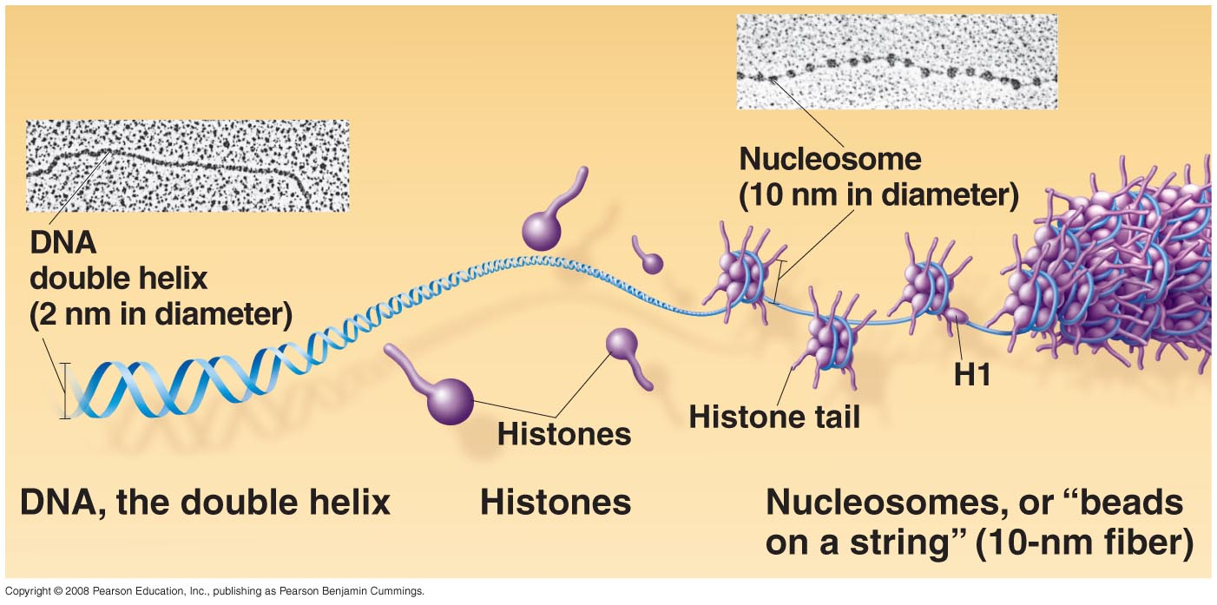
Eukaryotes genomes are packed with nucleosomes in the chromatin

Slide 4
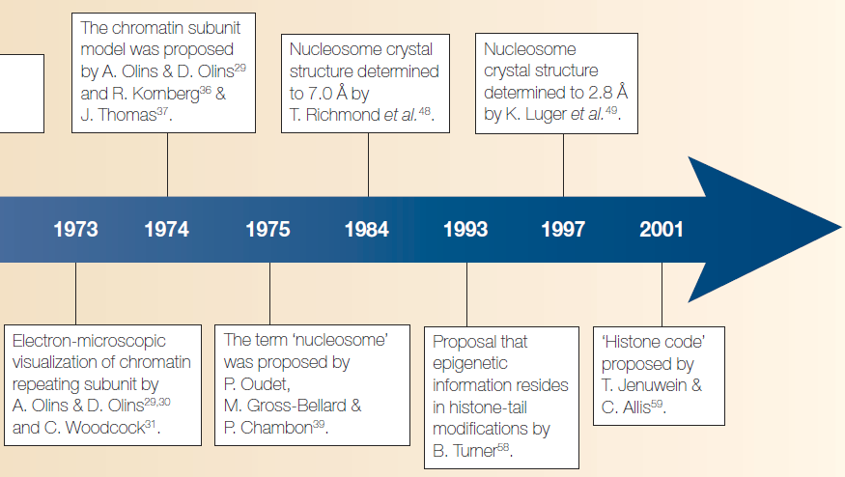
The history of the nucleosome
Olins & Olins (2013), Nature Rev. Mol Cell Biol., 4, 809-8014

Slide 5
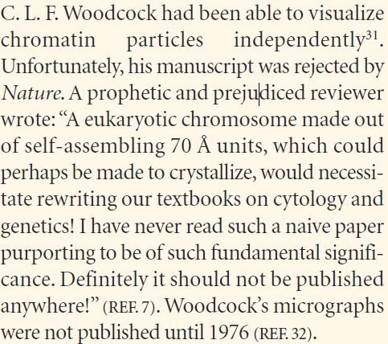
The history of the nucleosome
Olins & Olins (2013), Nature Rev. Mol Cell Biol., 4, 809-8014

Slide 6
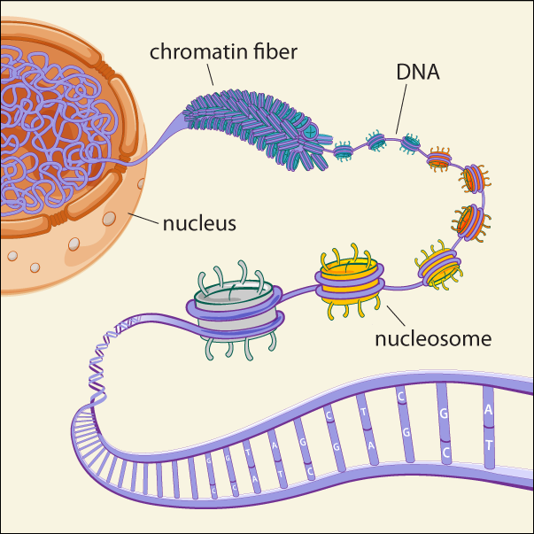
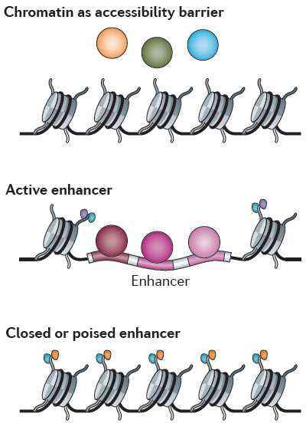
Nucleosome positioning influences gene regulation through DNA accessibility
Image courtesy of Broad Communications
Shuleva et al., Nature Rev. Genet., 2014

Slide 7
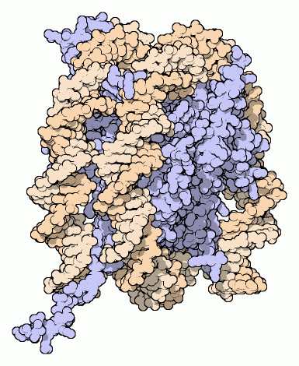
The nucleosome
Nucleosome, with DNA in orange and histone proteins in blue.
http://pdb101.rcsb.org/motm/7

Slide 8
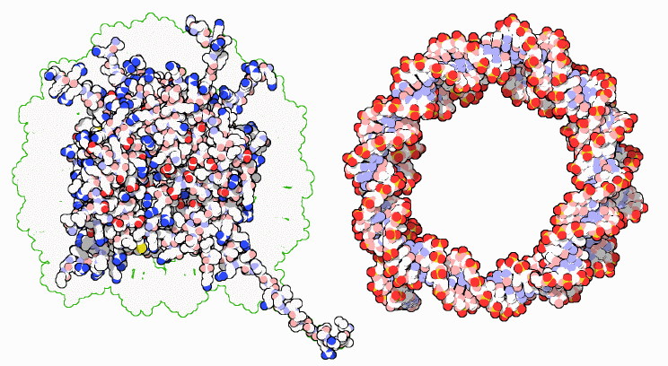
The nucleosome
Nucleosome histone proteins (left) and DNA (right)
http://pdb101.rcsb.org/motm/7

Slide 9
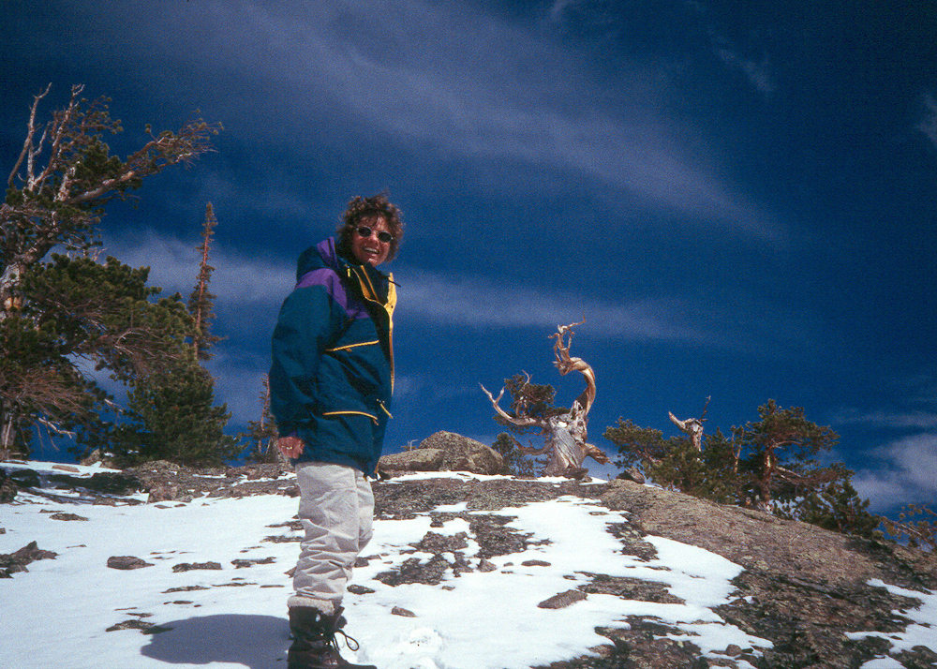
Caroline Luger – determined the structure of the nucleosome (1997)
https://en.wikipedia.org/wiki/Karolin_Luger

Slide 10
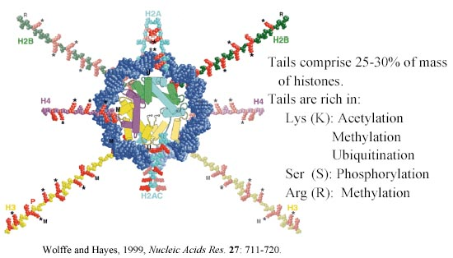
The nucleosome

Slide 11
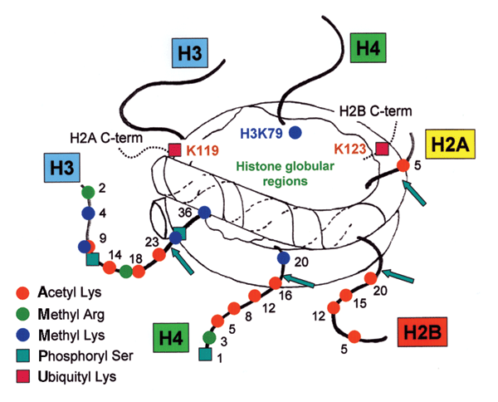
The nucleosome
Turner B.M. (2005) Nature Structural & Molecular Biology, 12, 110 - 112

Slide 12
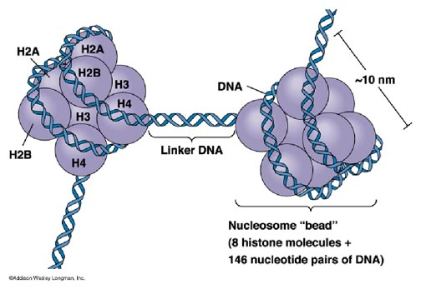
The nucleosome

Slide 13
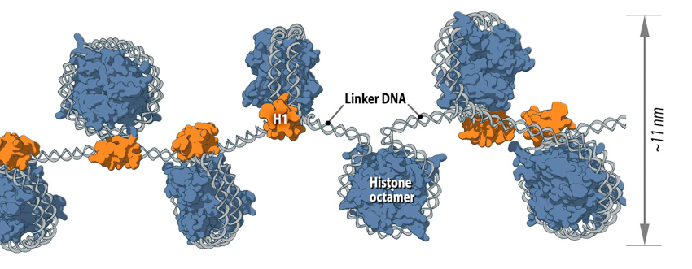
Nucleosome arrays in chromatin
https://www.mechanobio.info/topics/genome-regulation/dna-packaging/

Slide 14
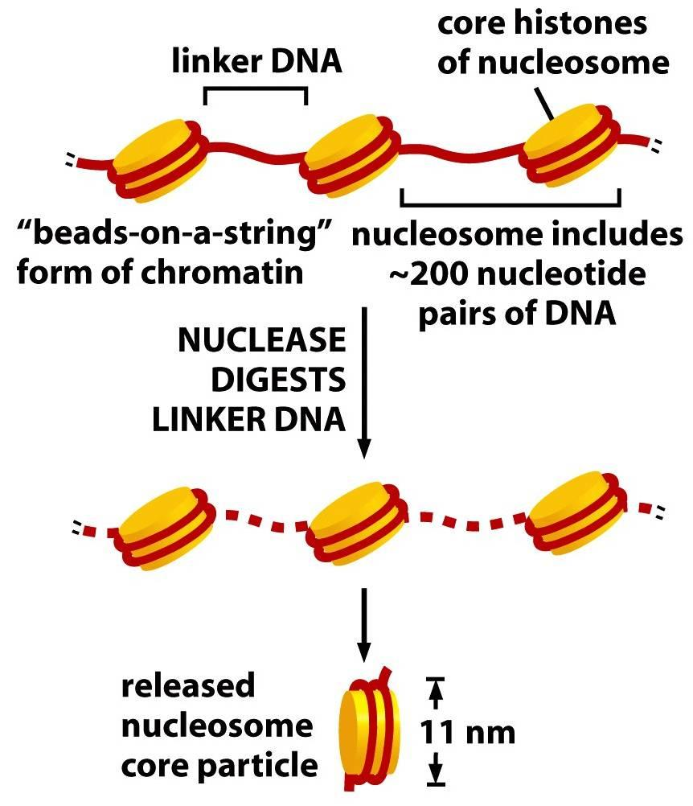
Nucleosome arrays in chromatin
Nucleosome includes
147 DNA base pairs
https://biology.stackexchange.com/questions/56627/is-nucleosomal-dna-ever-degraded

Slide 15
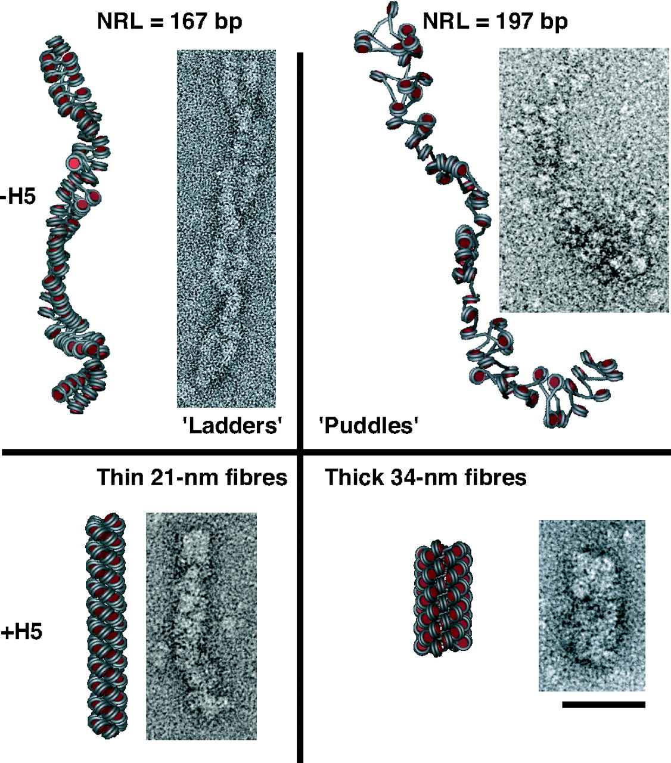
The average distance between centres of neighbouring nucleosomes, called the nucleosome repeat length (NRL), determines chromatin fiber compaction
Routh et al. (2008), PNAS, 105, 8872–8877

Slide 16
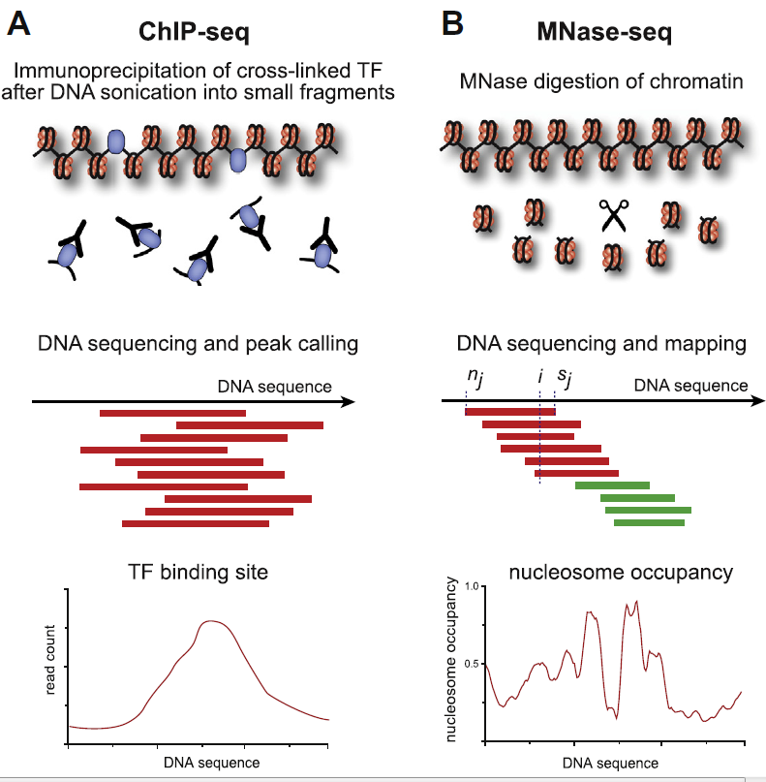
NGS methods to map nucleosomes
MM
MNase =
Micrococcal Nuclease (enzyme that cuts DNA, preferentially between nucleosomes)
Teif et al., Methods, 2012

Slide 17
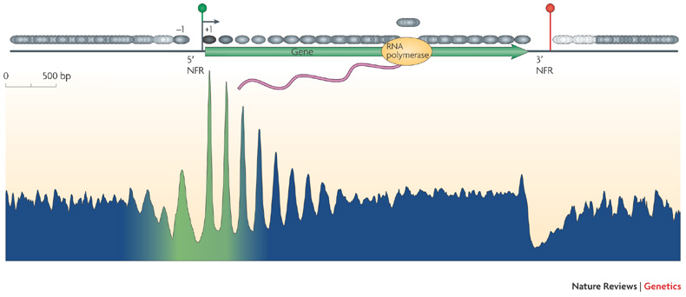
Nucleosomes near transcription start
Nucleosome occupancy
Transcription
start site (TSS)
3’-end
of gene
Jiang & Pugh, Nat Rev Genet., 2009

Slide 18
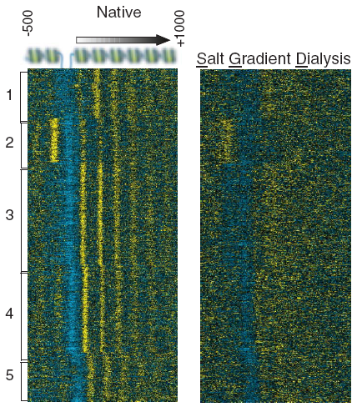
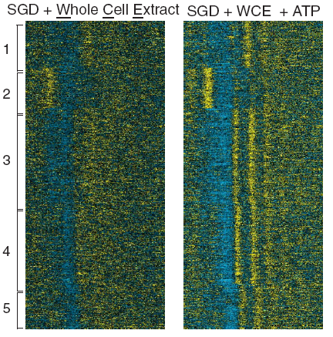
Nucleosomes are actively positioned
Each horisontal line on these heatmaps is one gene. Yellow colour shows higher nucleosome density; blue – nucleosome depletion.
Energy (ATP) is needed to reconstitute
nucleosome positioning as in living cells
TSS
DNA sequence alone can’t position nucleosomes
Zhang et al., Science, 2011

Slide 19
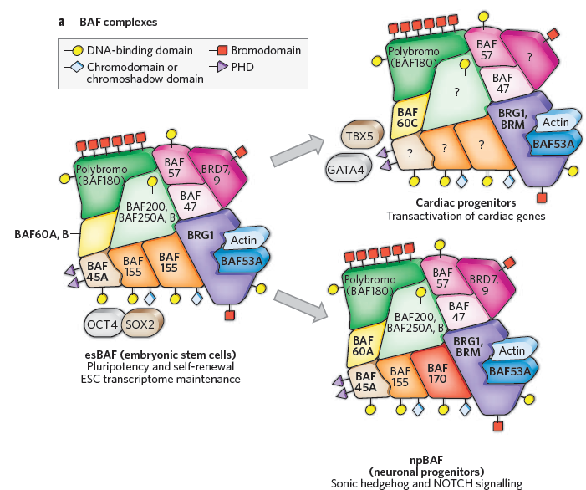
Remodelers are recruited to specific sites and reposition specific nucleosomes
Nucleosomes are positioned by “molecular motors”, so called chromatin remodellers
Ho & Crabtree,
Nature, 2010

Slide 20
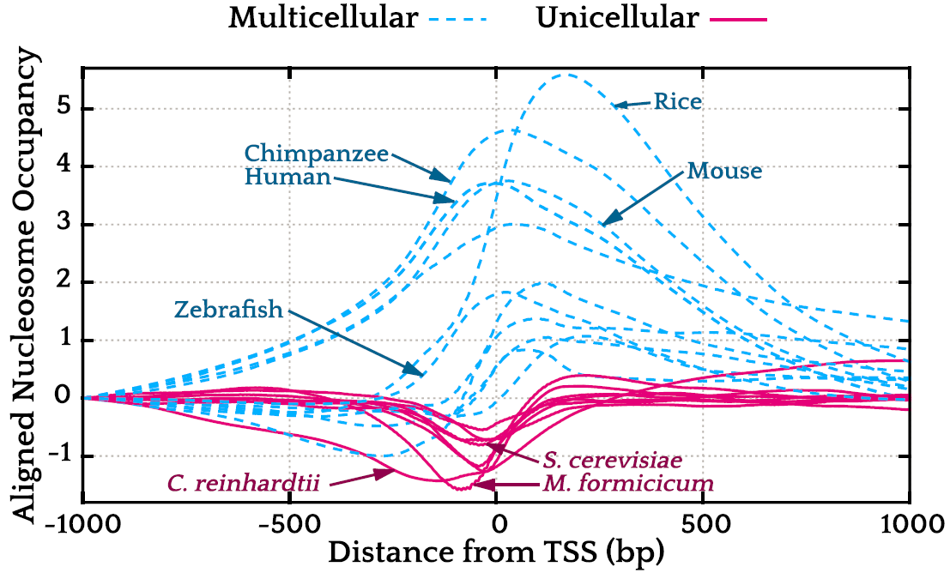
Multicellular organisms evolved to attract nucleosomes to promoters. in Yeast gene promoters are “open” by default In human, gene promoters are “closed” by default;
Tompitak et al. (2017), Biophys J. 112, 505–511

Slide 21
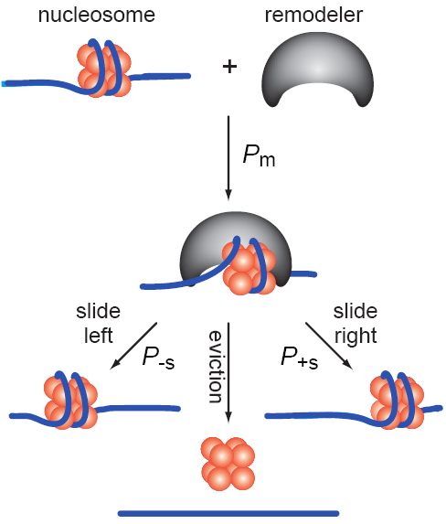
Nucleosome positioning changes during cell differentiation or activation
Human CD⁴⁺ T cells,
Schones et al., Cell, 2008
Teif and Rippe, Nucleic Acids Res., 2009

Slide 22
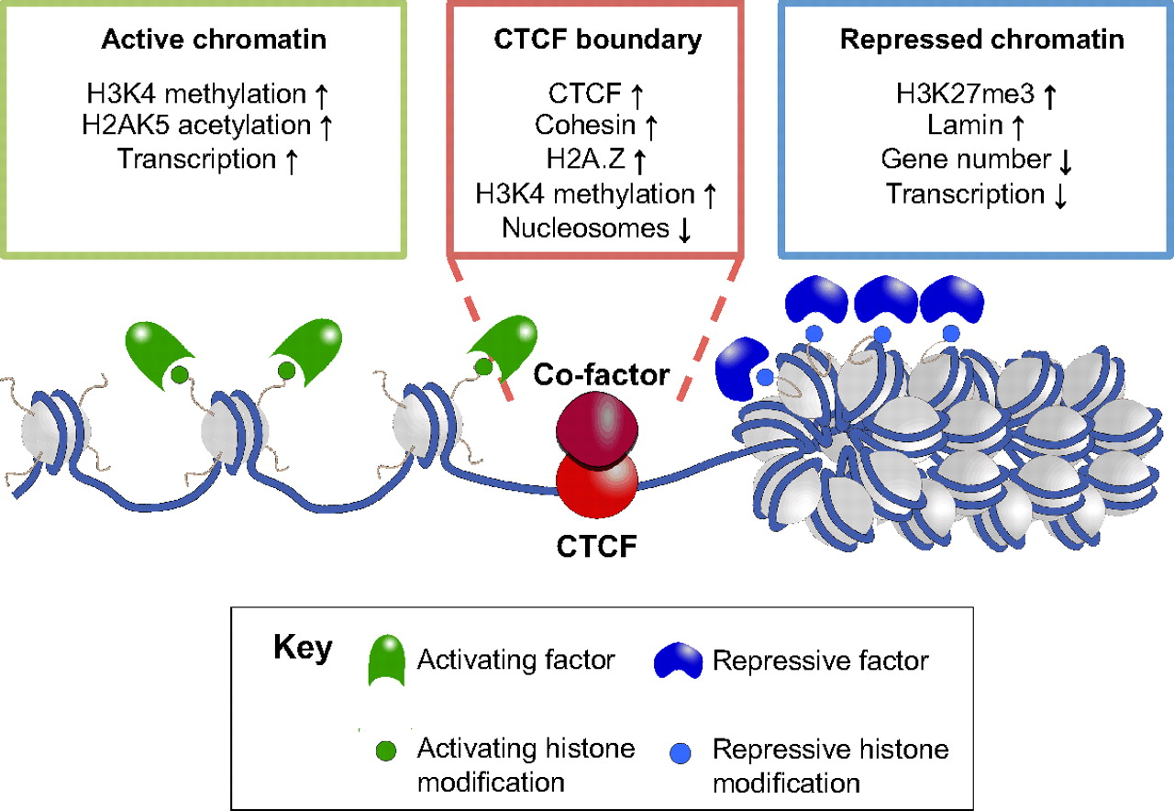
Next level of chromatin compaction: thousands to millions of DNA base pairs
http://dev.biologists.org/content/139/6/1045

Slide 23
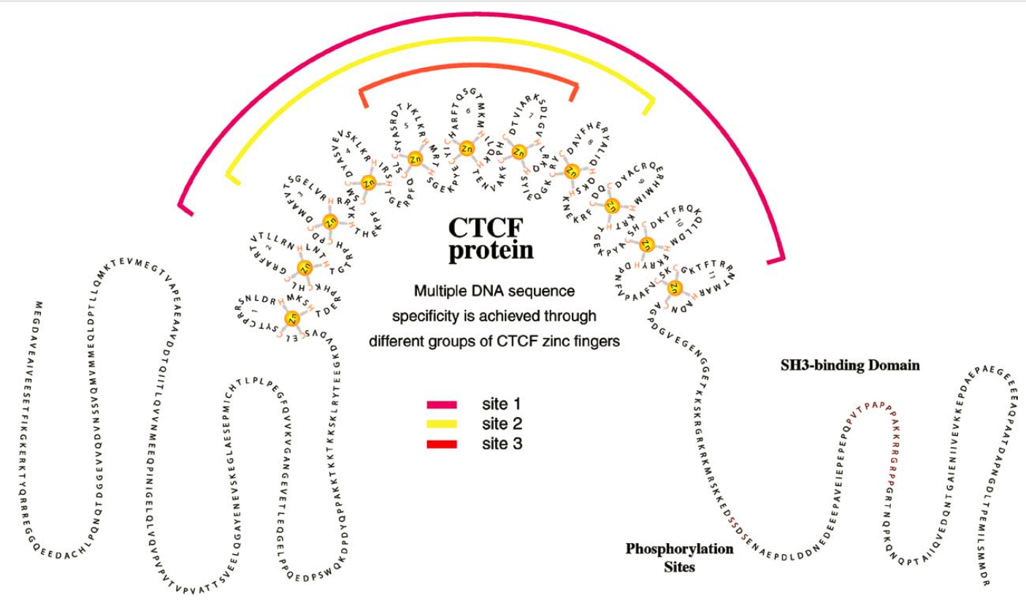
CCCTC-binding factor (CTCF protein)
Co-discovered
by Prof Elena Klenova from our school
(Klenova et al.,
Mol Cell Biol, 1993)

Slide 24
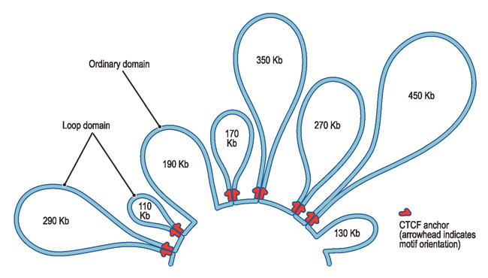
CTCF proteins can form chromatin loops and organise genome in 3D
https://www.seas.harvard.edu/news/2014/12/scientists-map-human-loop-ome

Slide 25
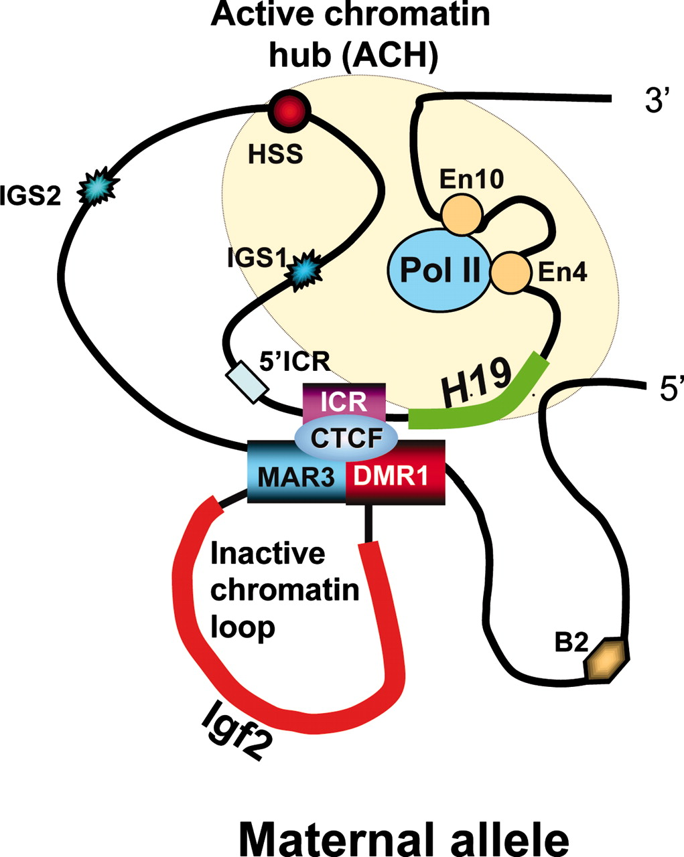
Example: CTCF binding at the H19 imprinting control region mediates maternally inherited higher-order chromatin conformation to restrict enhancer access to Igf2
Kurukuti et al. (2006), PNAS, 103, 10684–10689

Slide 26
CTCF-dependent looping
This gene is enclosed in the chromatin hub that contains several enhancers, and is active
This gene is isolated from all its enhancers and is inactive
Kurukuti et al. (2006) Proc Natl Acad Sci U S A. 103:10684-9

Slide 27
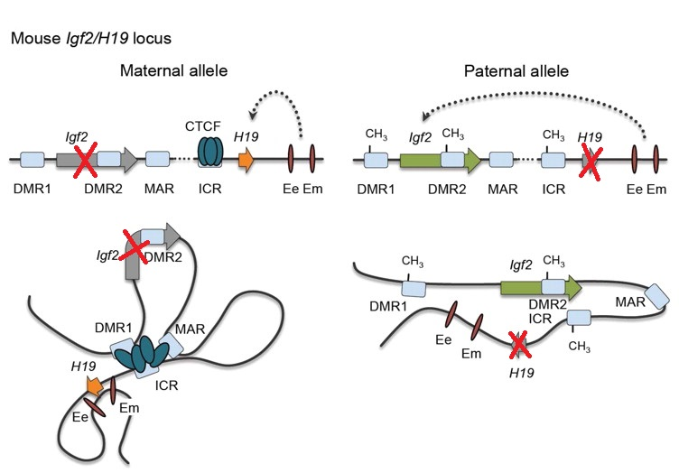
CTCF-dependent looping may be different in different cells → different gene expression
Aberrant CTCF binding is linked to:
Beckwith–Wiedemann syndrome;
Silver–Russell syndrome;
Cancer (different types).
De Almeida et al., Blood, 2012

Slide 28
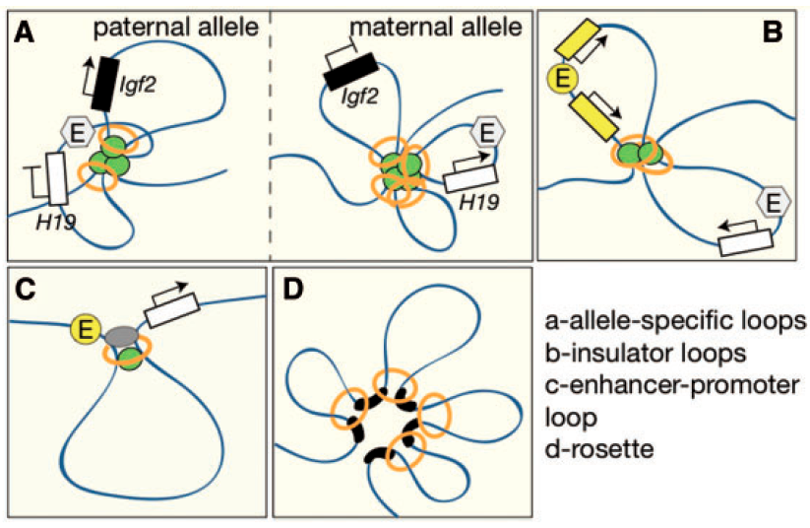
In addition to CTCF bridges there are also Cohesin rings that separate chromatin domains
Sofueva and Hadjur, Briefings in Functional Genomics, 3, 205-2016 (2012)

Slide 29
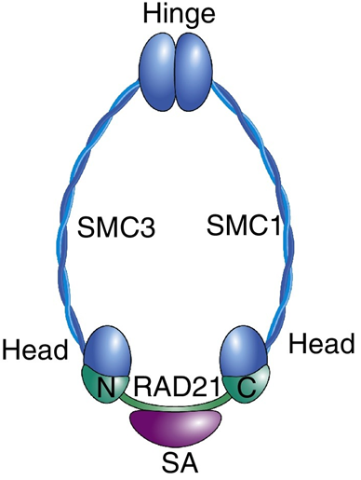
Cohesin is a ring-shaped protein complex that
“extrudes” CTCF-dependent chromatin loops
A Cohesin ring can slide along one or two DNA double helices until it encounters a CTCF protein. Then it stops and forms a chromatin boundary.
Singh and Gerton, Current Opinion in Cell Biology, 37, 9-11

Slide 30
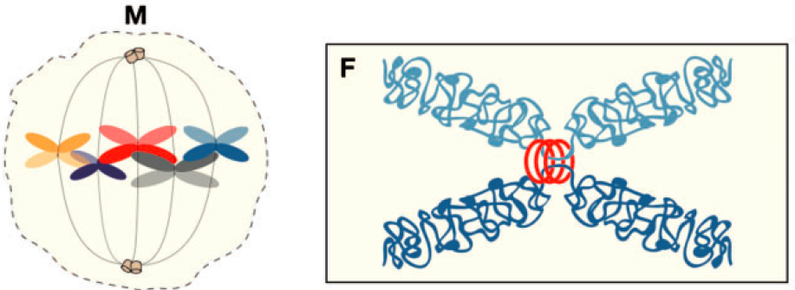
Cohesin rings can also connect different chromosomes during metaphase
Sofueva and Hadjur, Briefings in Functional Genomics, 3, 205-2016 (2012)

Slide 31
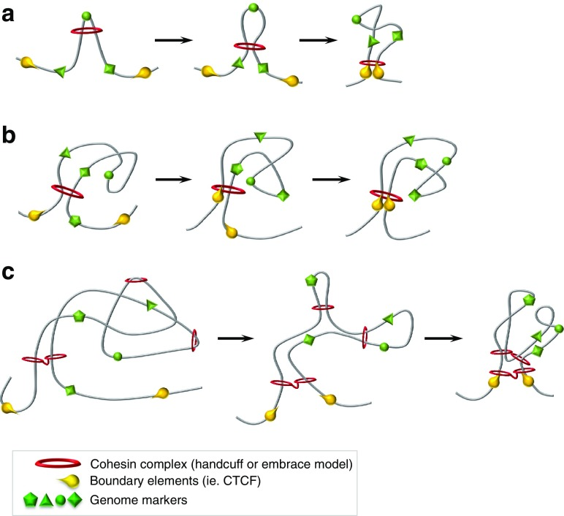
How does this work?
See lecturer’s demonstration
Barrington et al., Chromosome Res, 25, 51–60 (2017)

Slide 32
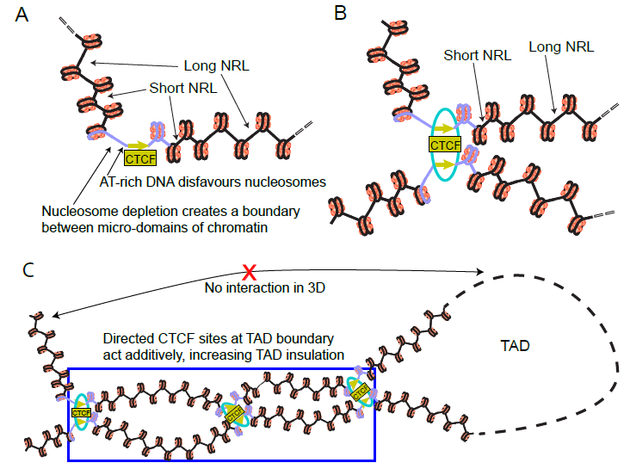
Our new findings (Clarkson et al., NAR, 2019)

Slide 33
Watch this video (at home)
https://www.youtube.com/watch?v=Q_KdrtsmYoE
Which aspects of 3D genome are still not understood by scientists?

Slide 34
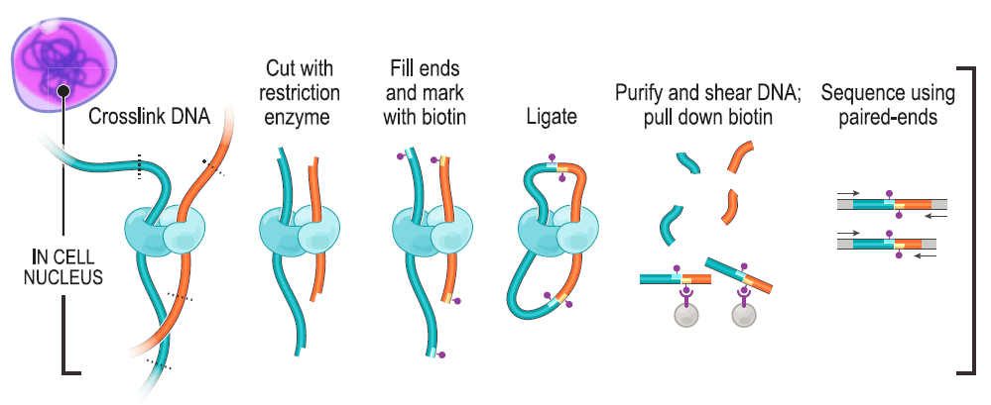
NGS methods to map 3D genome: Chromatin Conformation Capture, Hi-C
Rao et al., Nature 159, 1665–1680 (2014)

Slide 35
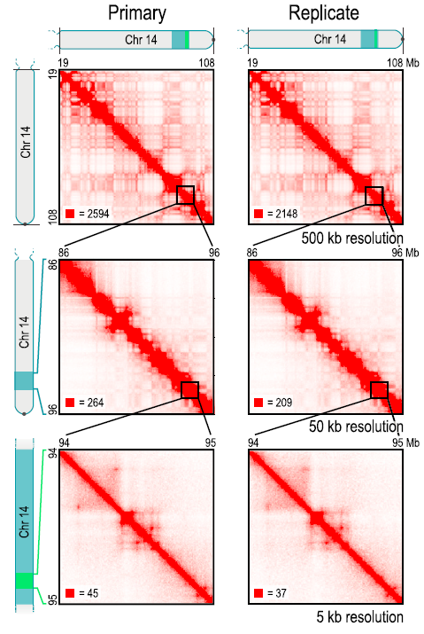
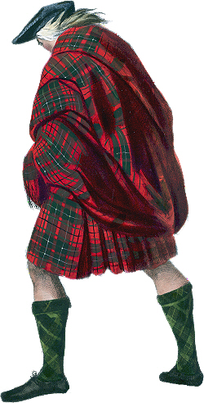
Hi-C: NGS method to map 3D genome
Main features of the Hi-C matrix:
The diagonal (self-contacts)
Plaid-like pattern (A/B domains)
(A: active, B: inactive)
Squares along diagonal (TADs)
(TAD = Topologically Associated Domain). It interacts only with itself, not with other regions
“Spots” off-diagonal (Loops)
Rao et al., Nature 159, 1665–1680 (2014)

Slide 36
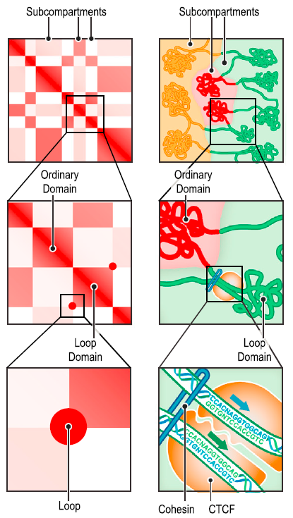
Hi-C: NGS method to map 3D genome
Main features of the Hi-C matrix:
The diagonal (self-contacts)
Plaid-like pattern (A/B domains)
(A: active, B: inactive)
Squares along diagonal (TADs)
(TAD = Topologically Associated Domain)
“Spots” off-diagonal (Loops)
Rao et al., Nature 159, 1665–1680 (2014)

Slide 37
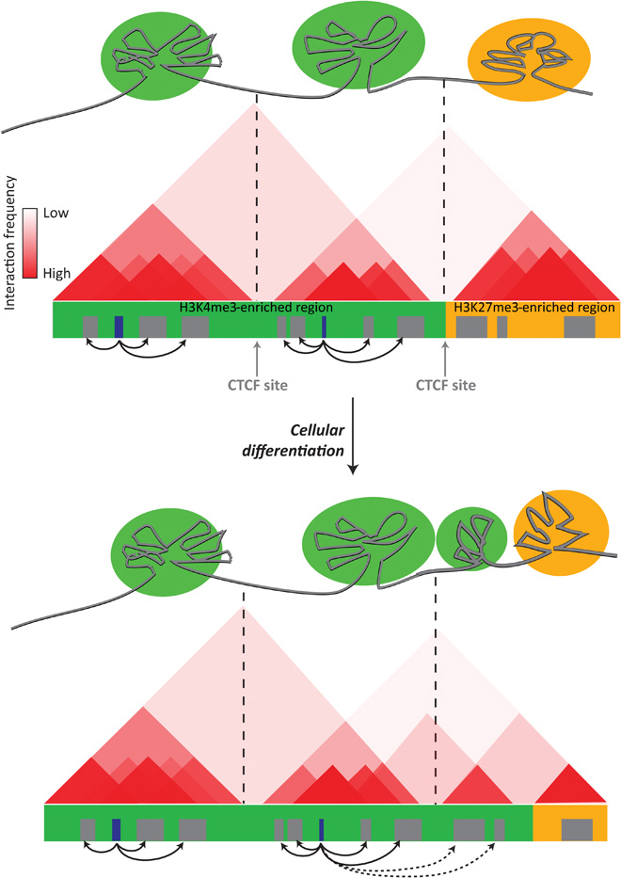
Topologically associated domains (TADs) change during the cell differentiation
Aranda et al. (2015), Science Advances, 1, e1500737

Slide 38
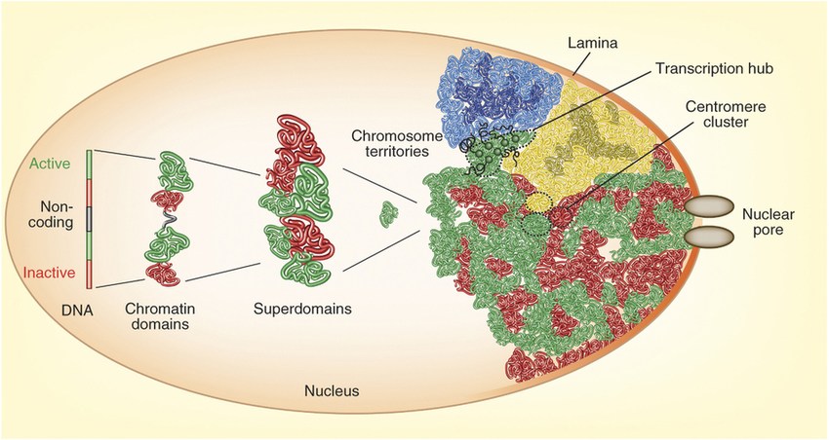
LARGE SCALE CHROMATIN ORGANIZATION
Cavalli and Misteli, Nature Structural & Molecular Biology 20(3):290-9, 2013

Slide 39
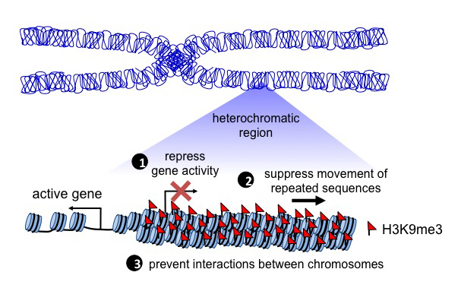
Heterochromatin vs euchromatin
https://atlasofscience.org/role-of-heterochromatin-in-establishing-and-changing-cell-fate/

Slide 40
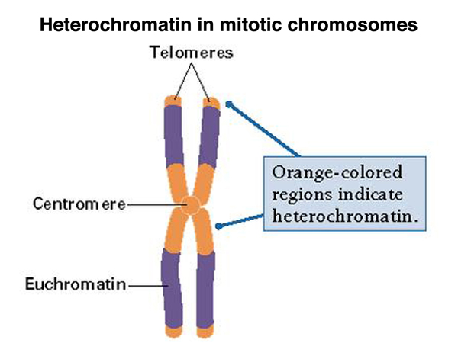
Gene expression is affected by 3D location
http://www.discoveryandinnovation.com/BIOL202/notes/lecture18.html

Slide 41
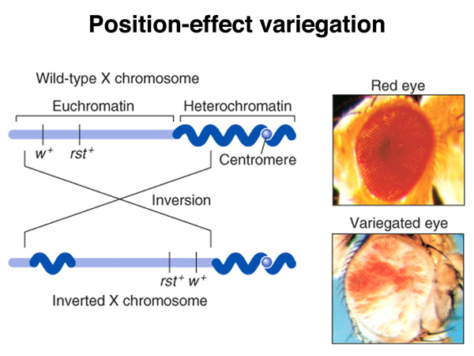
Gene expression is affected by 3D location
(Discovered in Drosophila, 1930)
http://www.discoveryandinnovation.com/BIOL202/notes/lecture18.html

Slide 42
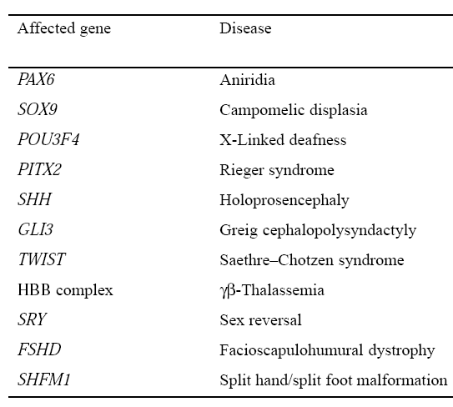
Effects of 3D gene location in human diseases
Kleinjan and van Heyningen (1998) Hum Mol Genet, 7(10), 1611–1618

Slide 43
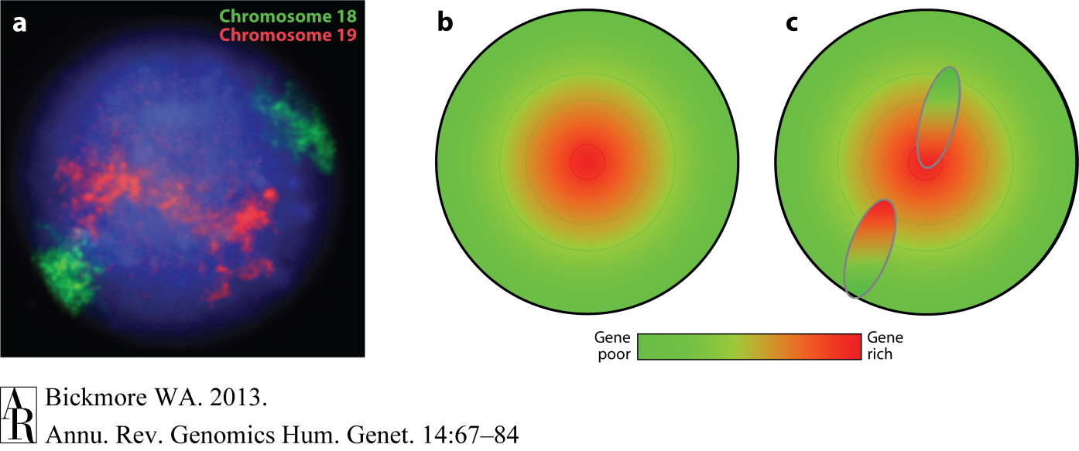
Chromosome-wide effects
Chromosome 18 is gene-poor, chromosome 19 is gene-rich
Gene-rich domains congregate at the centre of the nucleus
Translocations result in genes moving out of their ‘normal’
nuclear environment

Slide 44
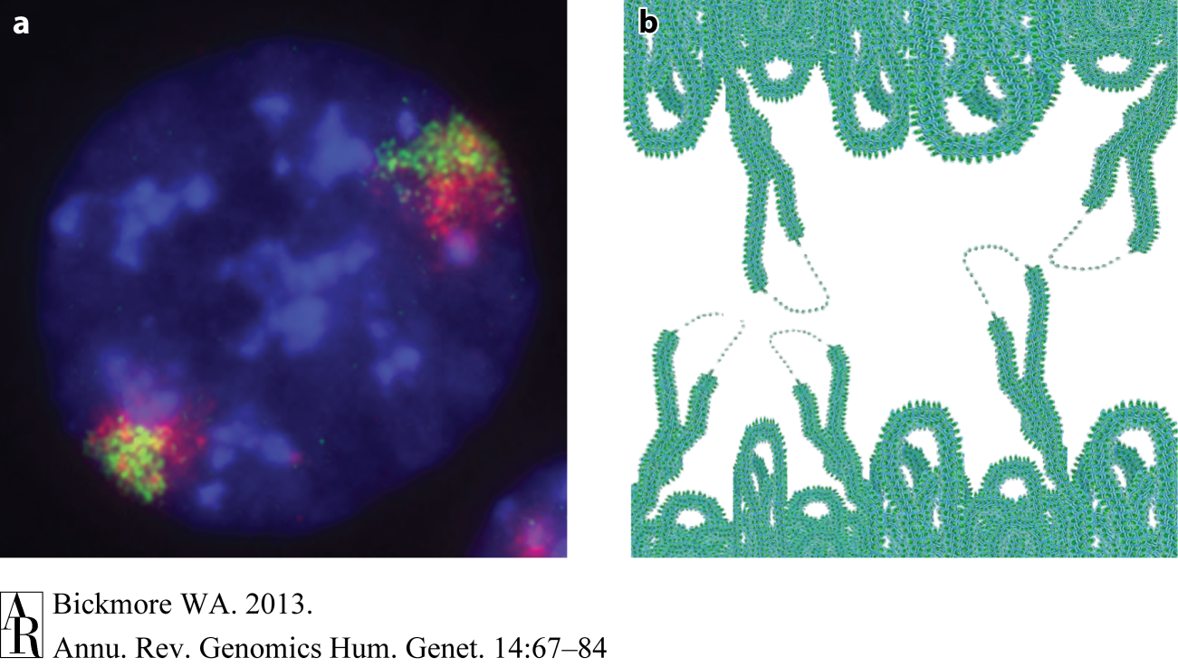
Genes (red) are seen to “loop out” from chromosome
This would enable distant regions to interact

Slide 45
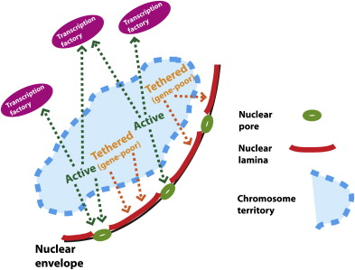
Genes located close to the nuclear membrane (lamina) tend to be silenced
Lamina-associated domains (“LADs”)
Dillon N. (2008) Dev. Cell 15(2), 182–186

Slide 46
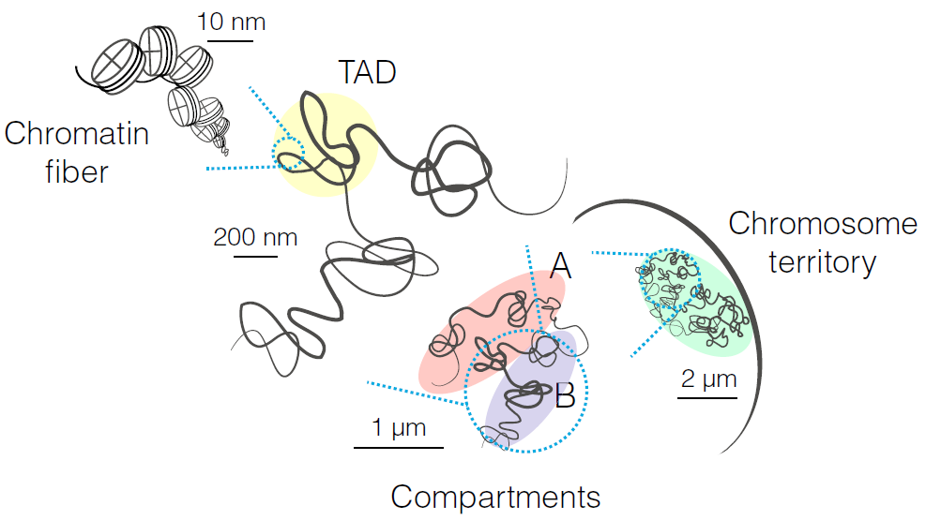
Summary of hierarchical genome folding
Nucleosome
“Topologically Associating Domain” that
interacts with itself and not other regions
Active (A) and inactive (B) chromatin compartments
Szabo et al., Science Advances, 2019

Slide 47
Take home message
Nucleosome positioning & 3D genome organisation modulates gene expression
MUST KNOW:
Chromatin, CTCF, Cohesin
NUCLEOSOME, NUCLEOSOME REPEAT LENGTH (NRL)
NGS methods to map nucleosomes
NGS METHODS TO MAP 3D GENOME CONTACTS
Chromatin domains, loops, A/B compartments
Topologically Associated Domains (TADs)
Lamina Associated Domains (LADs)

