Slide 1
Module introduction, genomes and sequencing projects
BS222 – Genome Science Lecture 1
Dr. Vladimir Teif

Slide 2
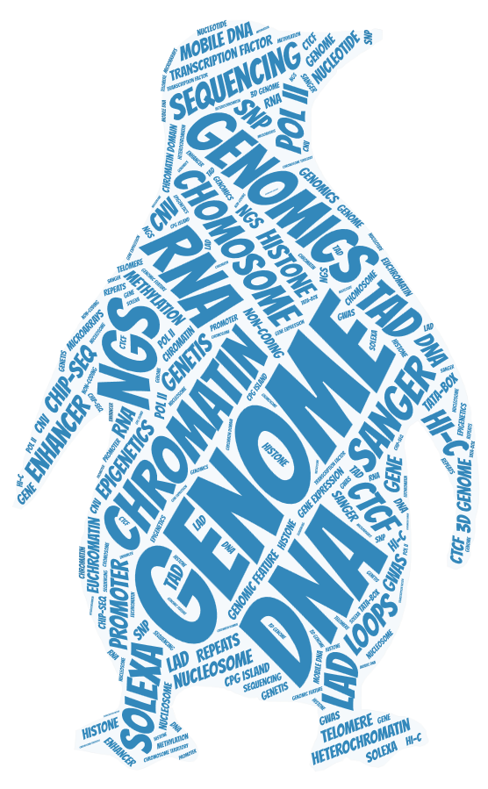
Welcome to BS222 Genome Science!

Slide 3
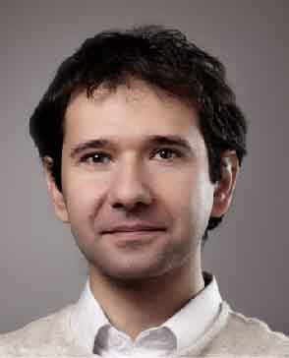
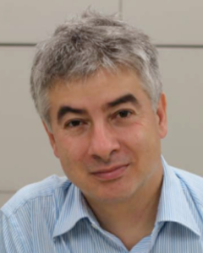
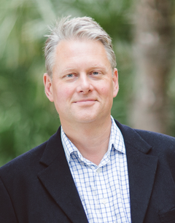

Meet your lecturers
Leonard
Schalkwyk
Ben Skinner
Vladimir Teif
(module
supervisor)
Patrick
Varga-Weisz

Slide 4
Module structure
Genomes, sequencing projects and genomic databases (VT)
Sequencing technologies (VT)
Genome architecture I: protein coding genes (VT)
Genome architecture II: transcription regulation (VT)
Genome architecture III: 3D chromatin organisation (VT)
Epigenetics overview (PVW)
DNA methylation and other DNA modifications (VT)
NGS applications I: Experiments and basic analysis (VT)
NGS applications II: Data integration (VT)
Comparative genomics (BS, guest lecture)
SNPs, CNVs, population genomics (LS, guest lecture)
Histone modifications (PVW)
Non-coding RNAs (PVW)
Genome Stability (PVW)
Transcriptomics (PVW)
Year's best paper (PVW)
Revision lecture (all lecturers; spring term)

Slide 5
Module structure
Lectures and practicals during the Autumn term
Practicals:
Wet lab: chromatin extraction and preparation for sequencing (PVW)
IT Lab practical: Part 1 – Next Generation Sequencing analysis 1 (VT)
IT Lab practical: Part 2 – Next Generation Sequencing analysis 2 (VT)
Coursework based on practicals & general questions (50% of total mark):
Deadline: 10 am Friday Week 11 (13th December 2019)
Revision lecture in the spring term
Exam at the end of the Spring term (50% of total mark)

Slide 6
Genome Science…
So what is the genome?
Genome is the complete set of genetic material present in a given cell or organism
The term genome was created in 1920 by Hans Winkler. It is a blend of words gene and chromosome
Genomes consist of genes, but not only genes

Slide 7
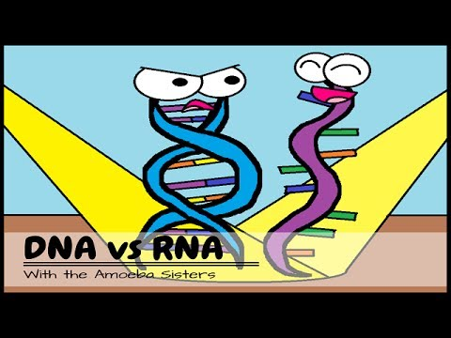
The human genome is made of DNA
…but some viruses have only RNA

Slide 8
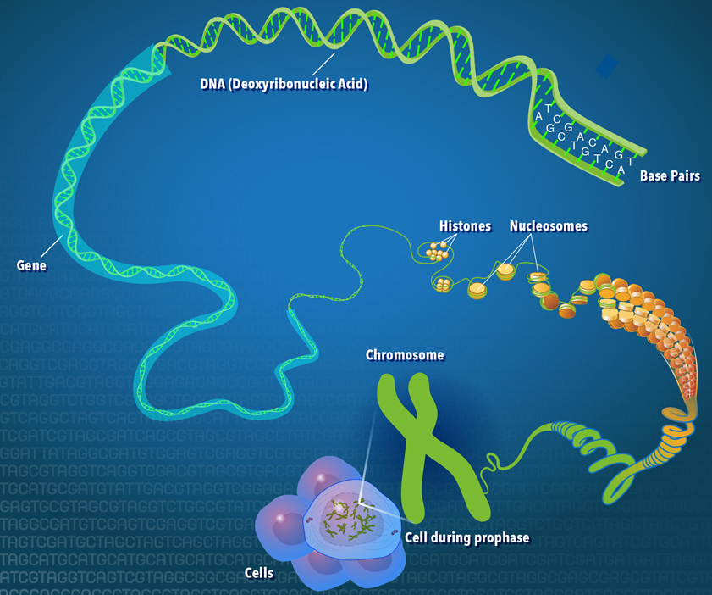
https://www.genome.gov/18016863/a-brief-guide-to-genomics/

Slide 9
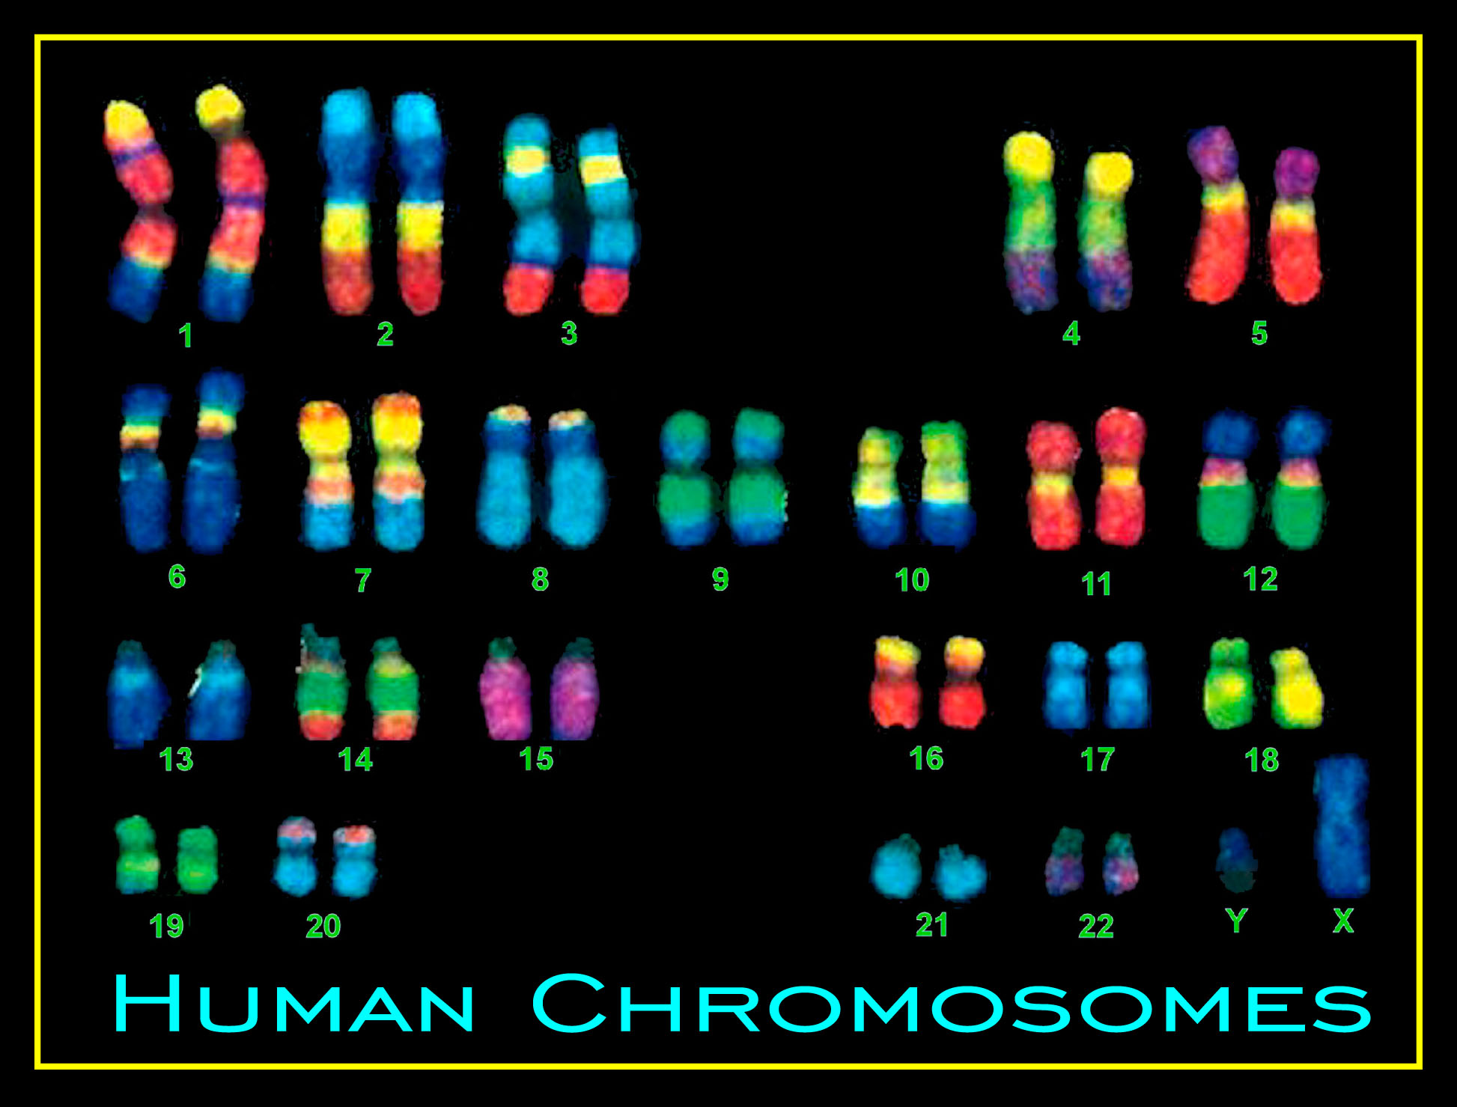

Slide 10
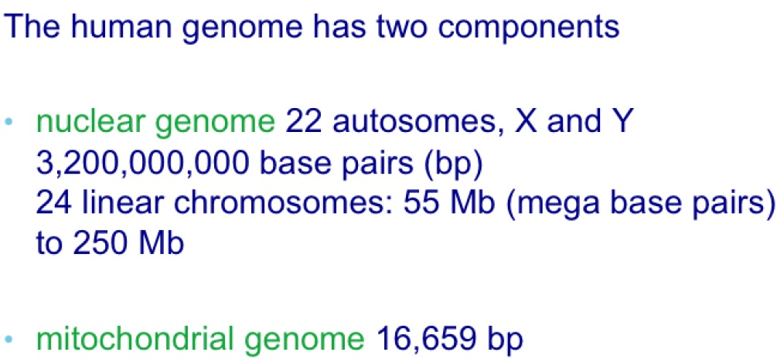
In addition to DNA in chromosomes in the cell nucleus, there is also DNA stored in the mitochondria

Slide 11
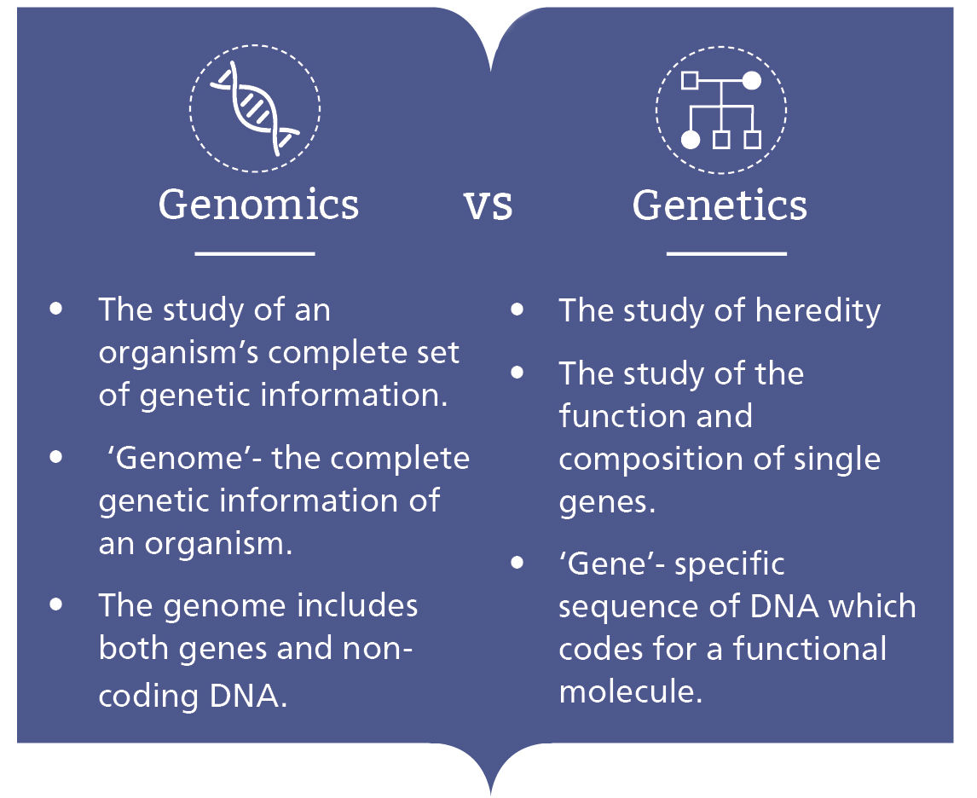
Genomics exists since 1990s
Genetics exists since 1900s

Slide 12
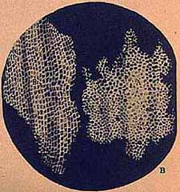
Robert Hooke (1635-1703) observed cork cells with microscope
https://ucmp.berkeley.edu/history/hooke.html

Slide 13
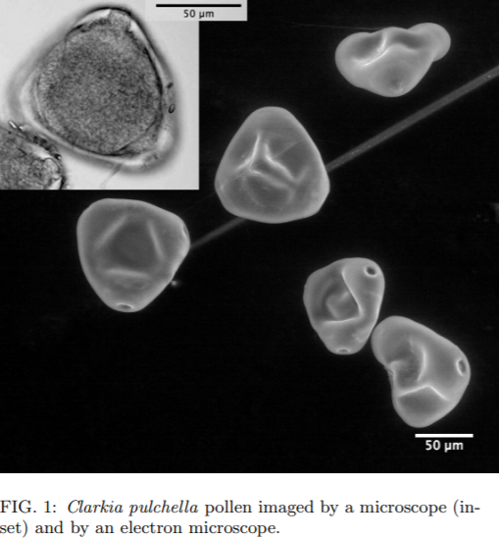
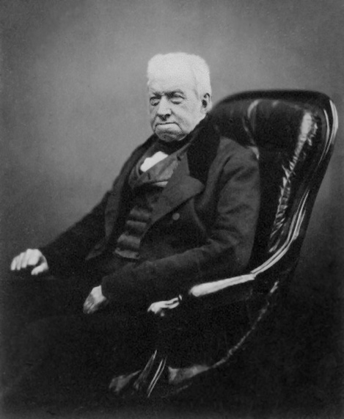
Robert Brown (1773-1858) discovered the cell nucleus
https://arxiv.org/pdf/1008.0039.pdf

Slide 14
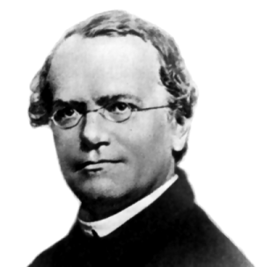
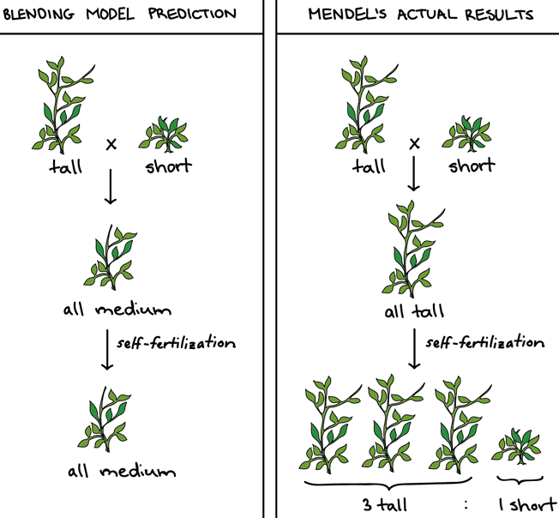
Gregor Mendel (1822-1884)
“Father of genetics”
In 1865, proposed how inheritance works. Although he did not use the term gene, his results can be explained only by genes existance.
https://www.khanacademy.org/science/high-school-biology/hs-classical-genetics/hs-introduction-to-heredity/a/mendel-and-his-peas

Slide 15
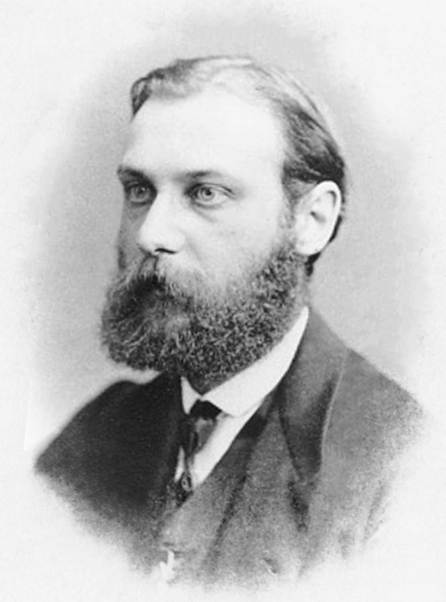
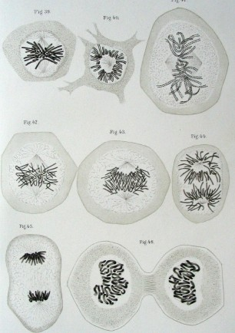
Walther Flemming (1843-1905) discovered chromosomes
Illustrations of cells with chromosomes and mitosis, from the book Zellsubstanz, Kern und Zelltheilung, 1882

Slide 16
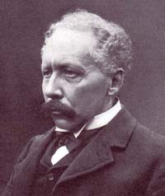
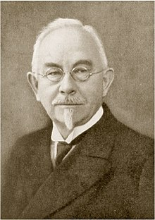
William Bateson (1861-1926)
Re-discovered and popularised works of Mendel and in 1905 proposed the term “genetics” (from Greek "to give birth“)
Wilhelm Johannsen (1857-1927)
Proposed terms gene (German Gen, Greek “generation”, phenotype and genotype (1909)

Slide 17
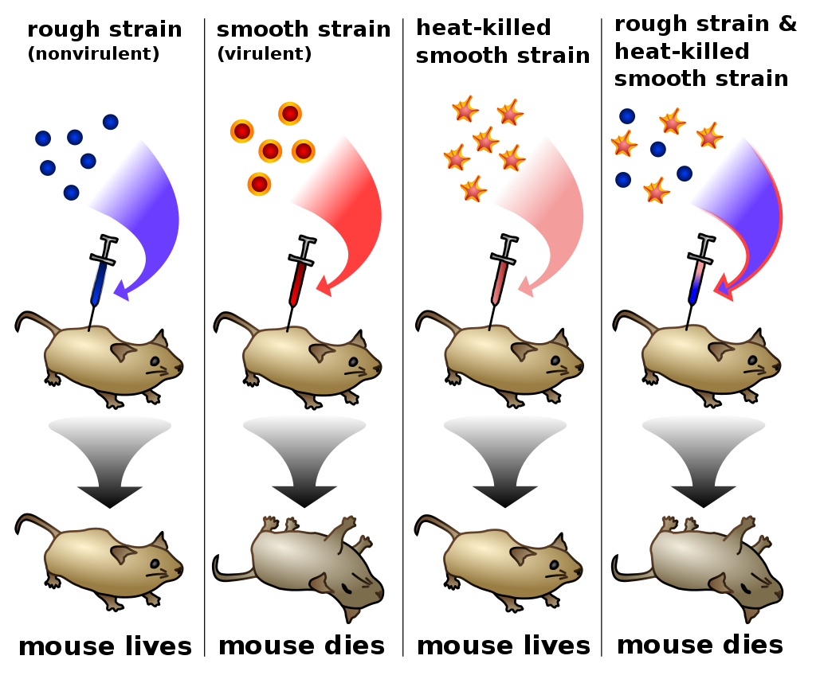
1944: Genes are encoded in DNA
Oswald Avery,
Colin MacLeod, and Maclyn McCarty

Slide 18
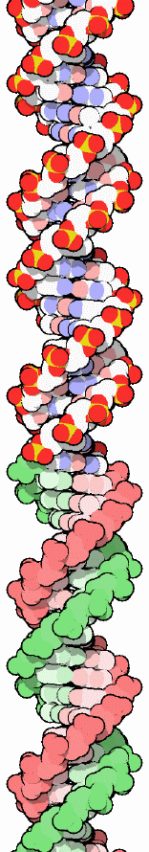
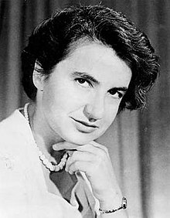
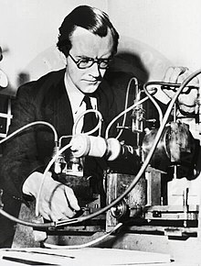
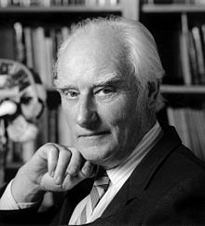
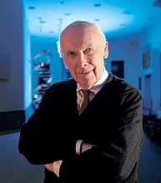
1953: DNA is a double helix
→information transfer explained
James Watson
Francis Crick
Rosalind Elsie Franklin
Maurice Wilkins
http://pdb101.rcsb.org/motm/23

Slide 19
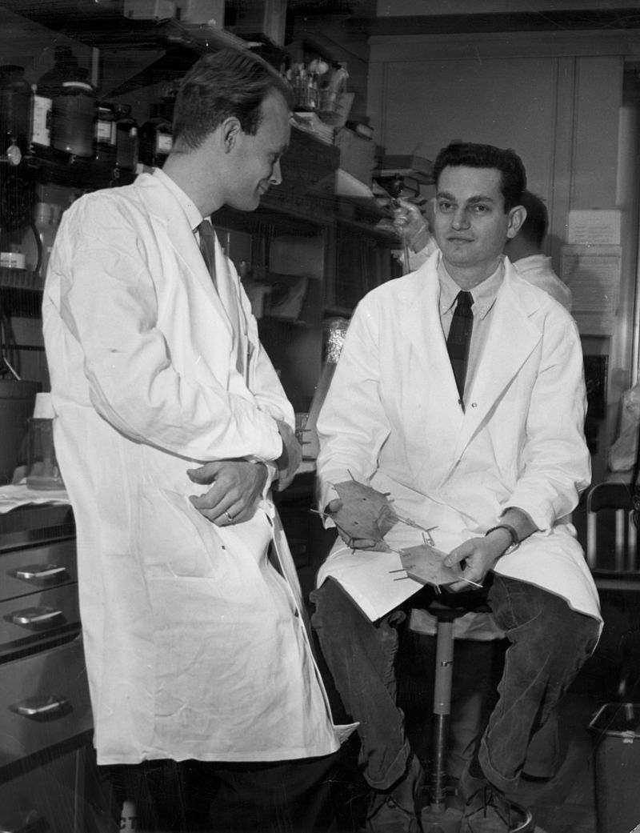
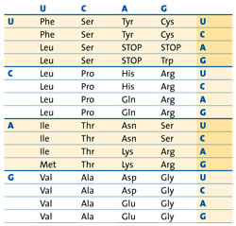
1966: DNA triplet code deciphered by M.W. Nirenberg and J.H. Mattai
A/T/G/C DNA nucleotides encode 20 amino acids
https://www.acs.org/content/acs/en/education/whatischemistry/landmarks/geneticcode.html

Slide 20
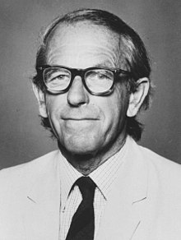
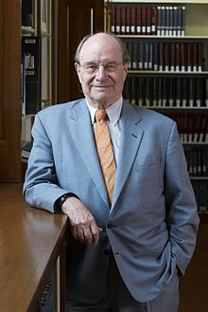
1975: 1st DNA sequencing method
Frederick Sanger & Walter Gilbert
Sanger and Gilbert made it possible to read the nucleotide sequence for entire genes, which run from 1,000 to 30,000 bases long

Slide 21
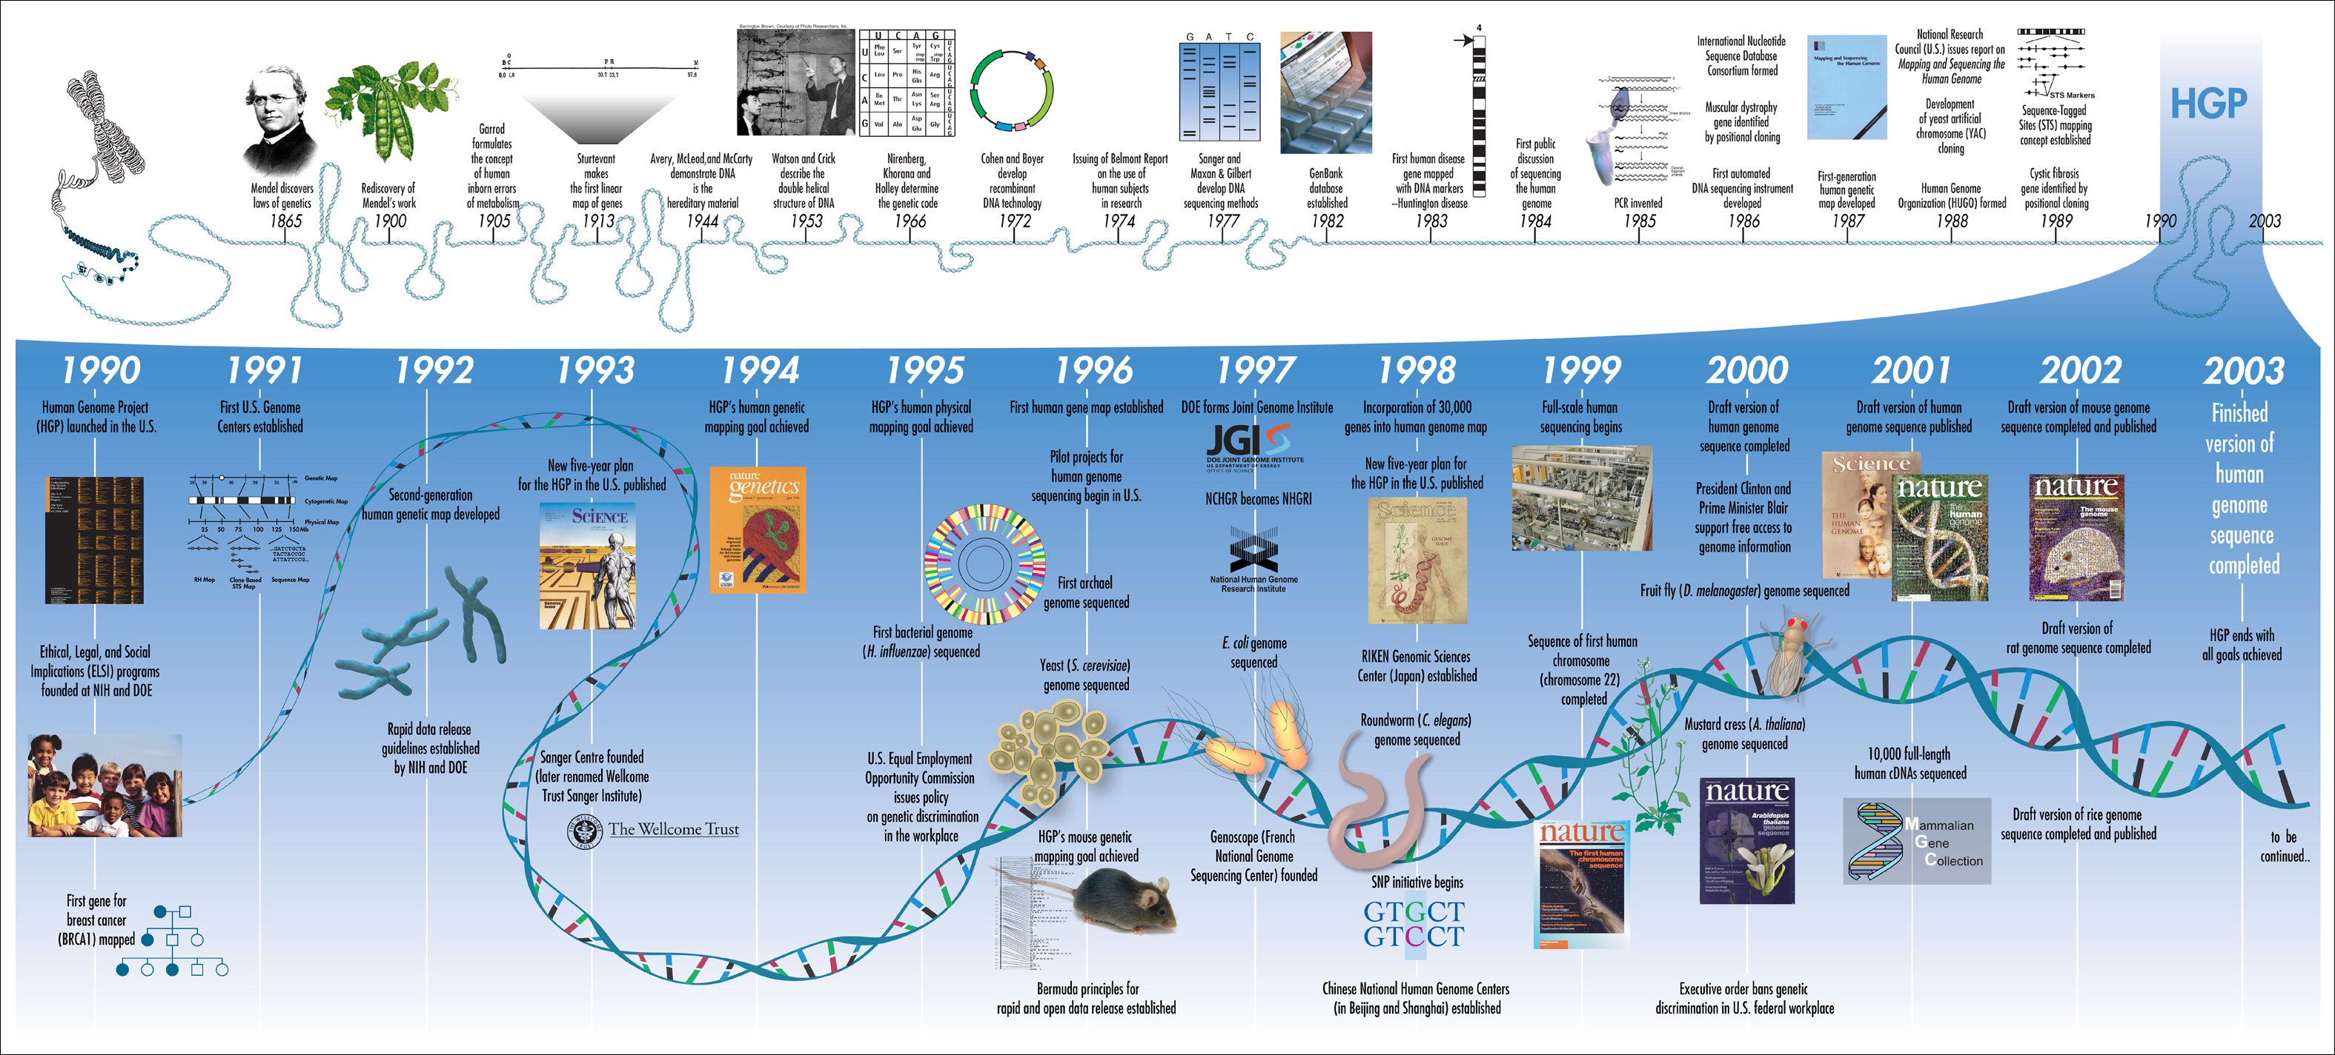
The Human Genome Project (1990-2003)
https://www.genome.gov/25019887/online-education-kit-timeline-from-darwin-and-mendel-to-the-human-genome-project/

Slide 22
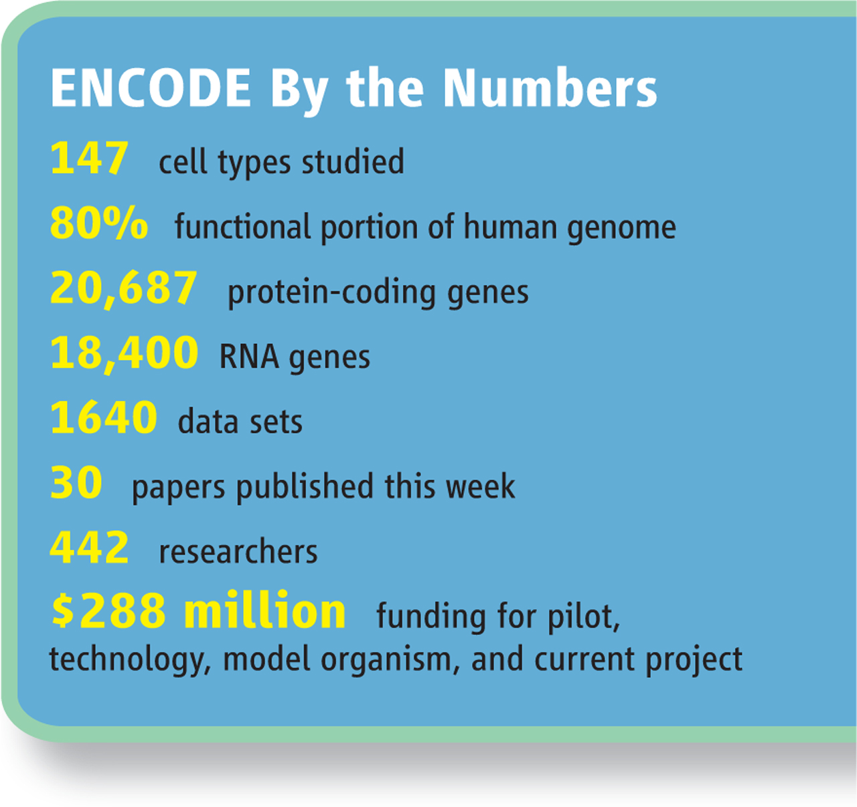
The ENCODE Project (2003-2013)
“Encyclopedia of DNA Elements”
The goal of ENCODE is to build a comprehensive parts list of functional elements in the human genome, including elements that act at the protein and RNA levels, and regulatory elements that control cells and circumstances in which a gene is active.

Slide 23
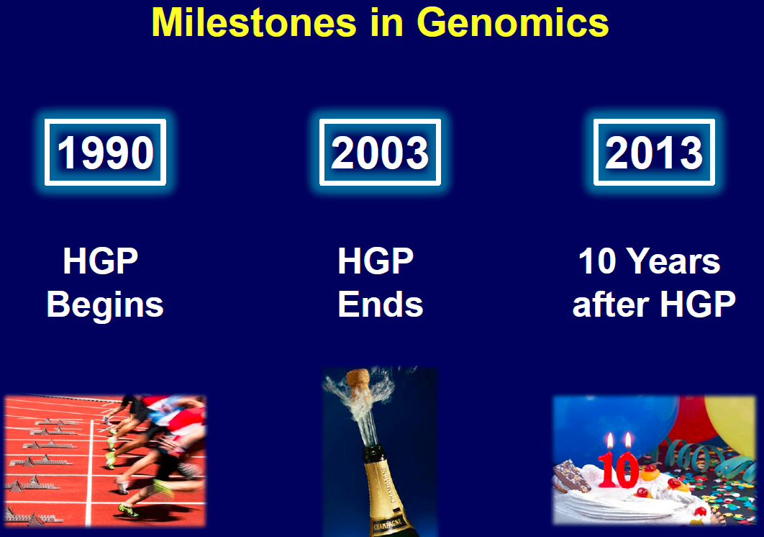
https://www.genome.gov/multimedia/slides/hgp10symposium/01_green.pdf

Slide 24
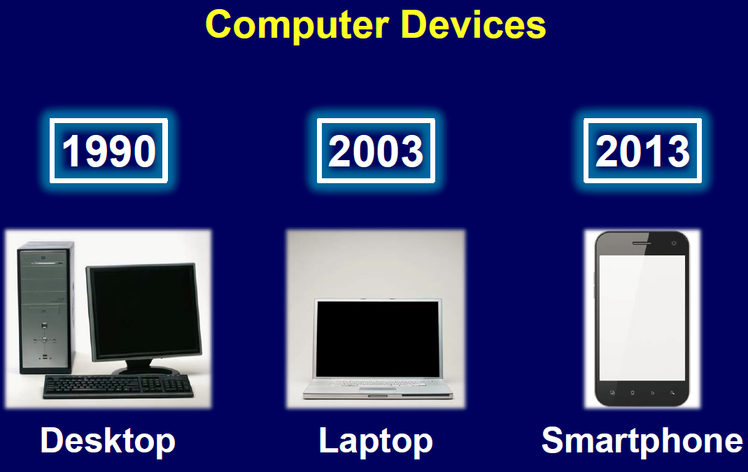
https://www.genome.gov/multimedia/slides/hgp10symposium/01_green.pdf

Slide 25
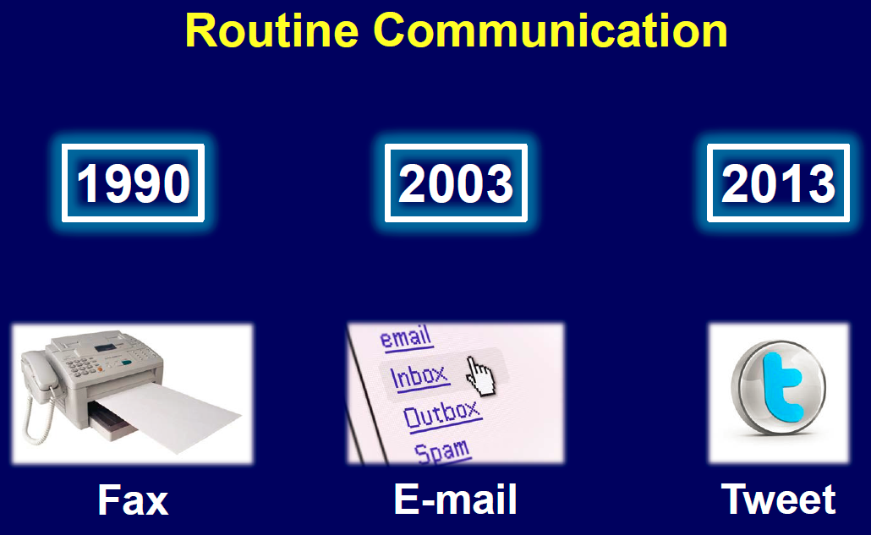
https://www.genome.gov/multimedia/slides/hgp10symposium/01_green.pdf

Slide 26
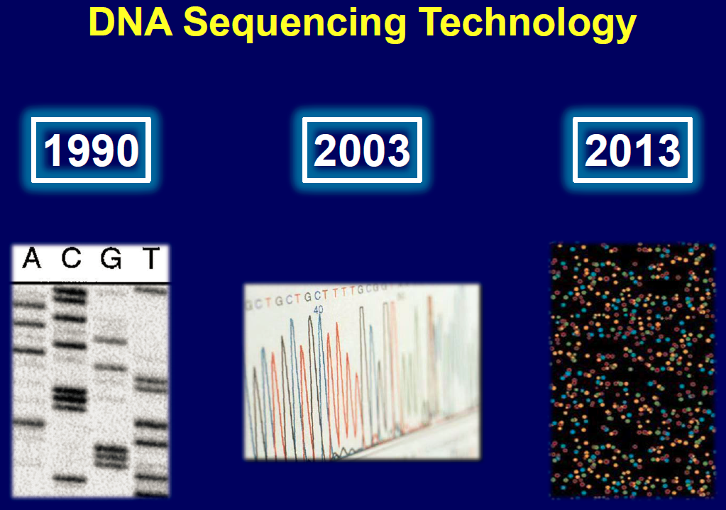
https://www.genome.gov/multimedia/slides/hgp10symposium/01_green.pdf

Slide 27
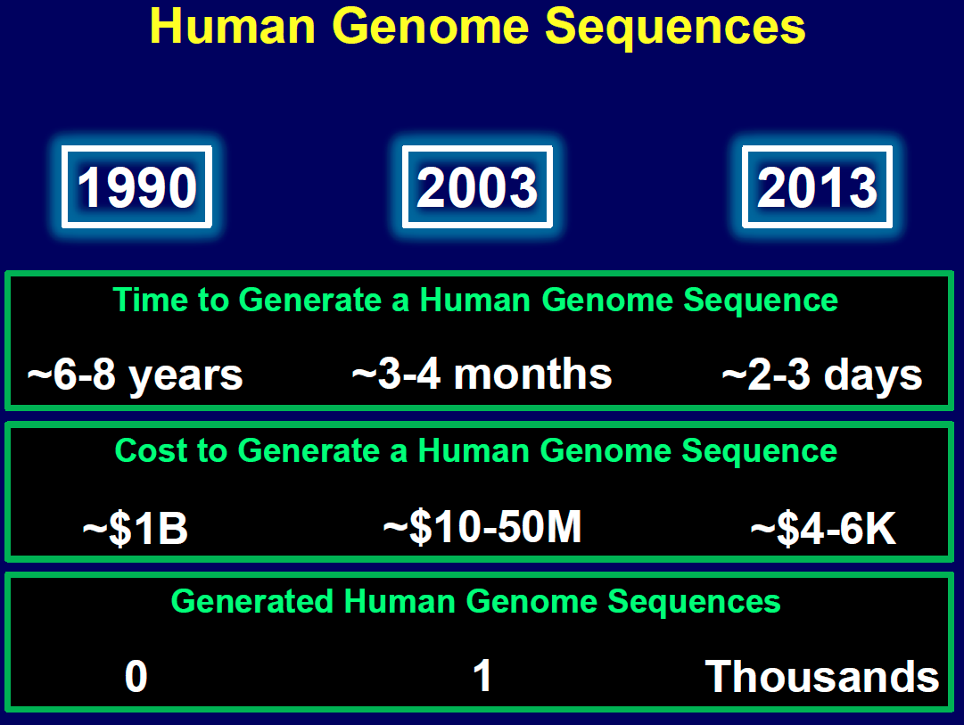
https://www.genome.gov/multimedia/slides/hgp10symposium/01_green.pdf

Slide 28
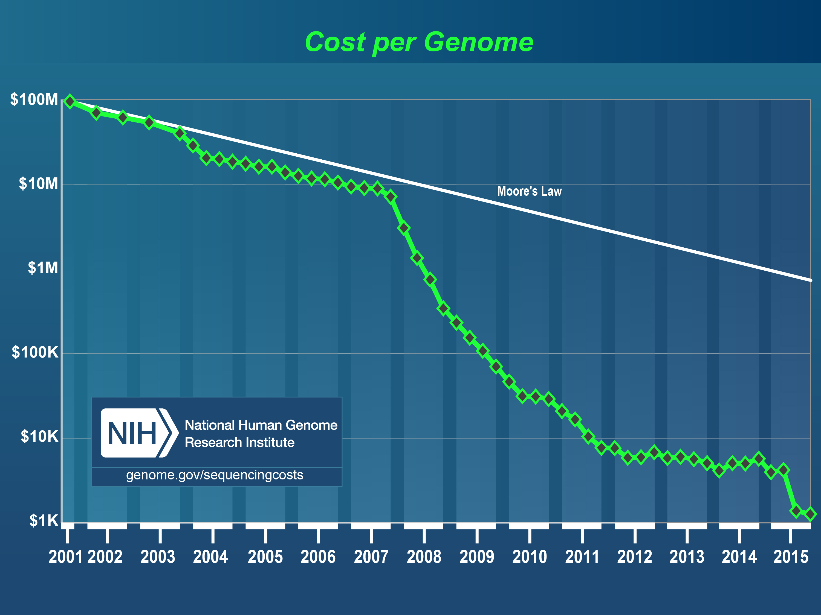

Slide 29
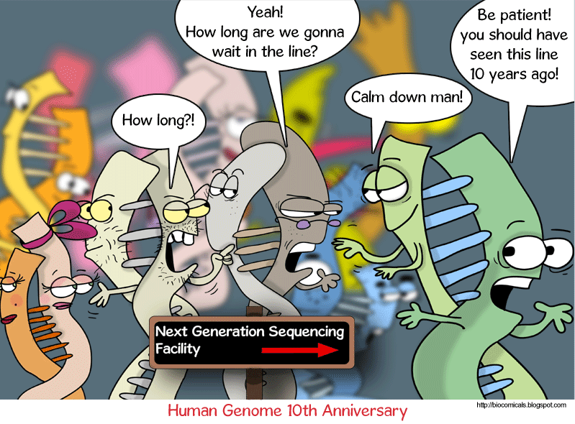
After the Human Genome Project

Slide 30
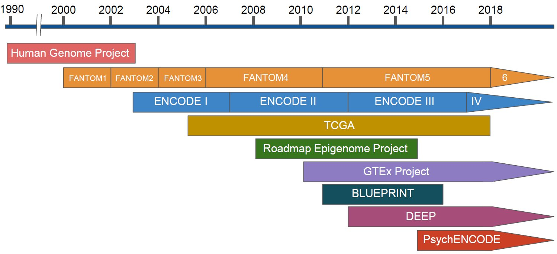
Some other big sequencing projects:
See the review article on this topic on Moodle:
Pratt & Weng (2018), Curr Opin Syst Biol, 11, 82-90

Slide 31
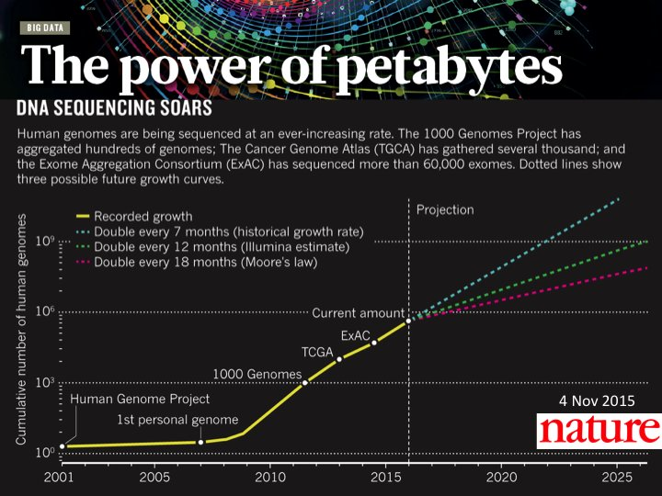

Slide 32
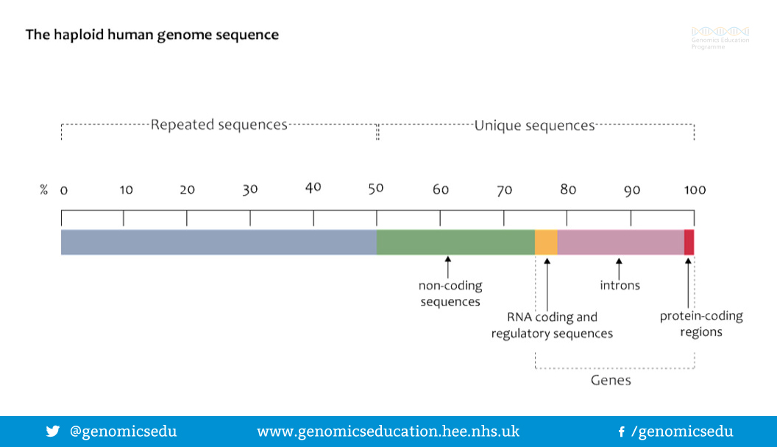
How large portion of the human genome is coding proteins?

Slide 33
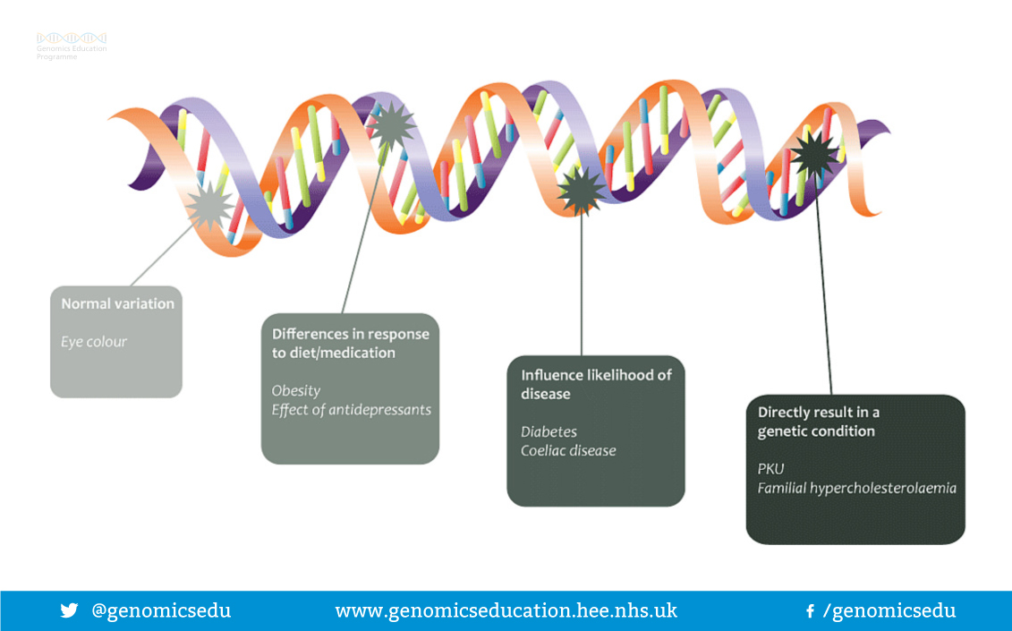
All people have different genomes
(~99% is the same)

Slide 34
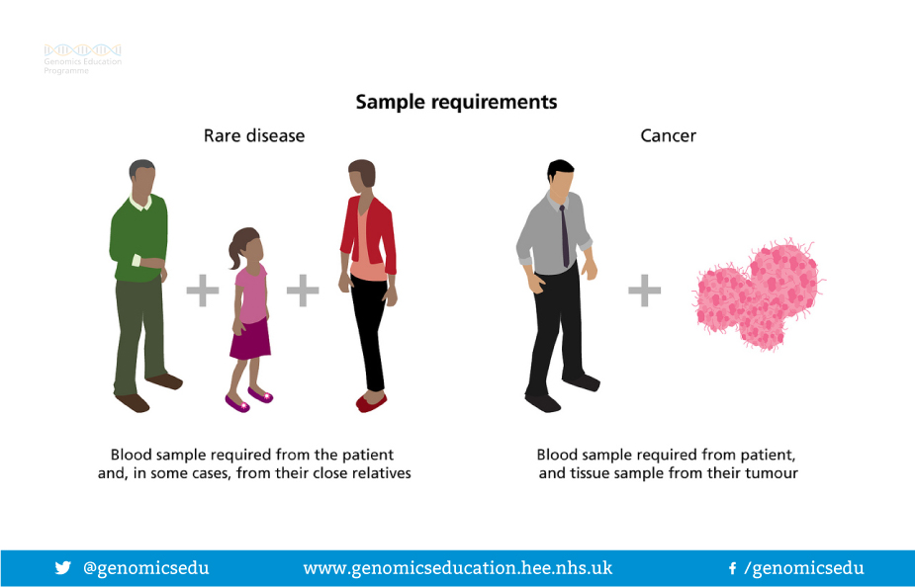
The 100,000 Genomes Project

Slide 35
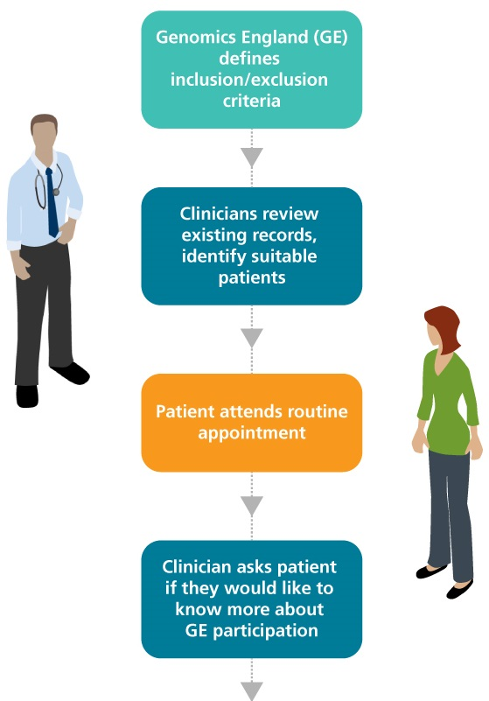
The 100,000 Genomes Project
The project’s aim: sequence 100,000 genomes from around 85,000 people. Participants are NHS patients with a rare disease, plus their families, and patients with cancer.
50,000 genomes from cancer – two per patient, therefore 25,000 patients.
50,000 from rare disease – three per patient (affected person plus two blood relatives)
https://www.genomicsengland.co.uk/the-100000-genomes-project/

Slide 36
The 100,000 Genomes Project already sequenced more than 100,000 genomes
“To date, actionable findings have been found for 1 in 5 rare disease patients, and around 50% of cancer cases contain the potential for a therapy or a clinical trial”
https://www.genomicsengland.co.uk

Slide 37

You can sequence your own genome

Slide 38
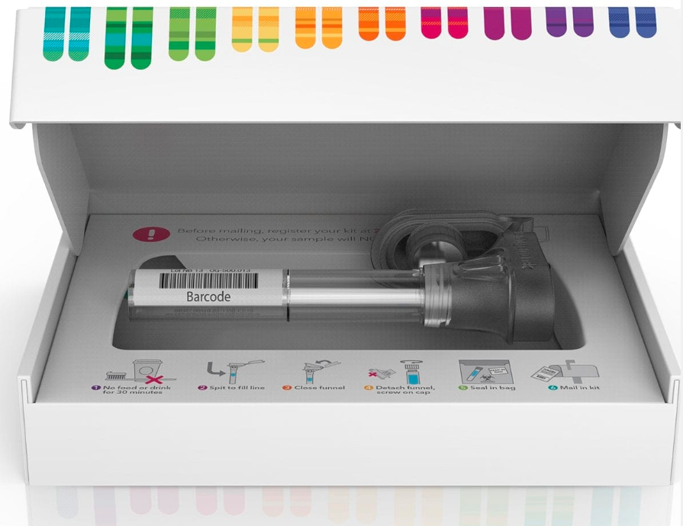
You can sequence your own genome
This is the kit from “23 and me”. You spit in the tube, send this box by post and receive results in several days
Be cautions about their results interpretation!

Slide 39
Take home message
Genome science is about sequencing, understanding genomes & applications
MUST KNOW:
Genome, genomics, genetics
CELL, NUCLEUS, CHROMOSOME, DNA, RNA, SEQUENCE
Understand the history of the field
THE HUMAN GENOME PROJECT; THE ENCODE PROJECT
THE 100,000 GENOMES PROJECT

Slide 40
Appendix

Slide 41
Landmarks in the history of genetics
http://www.dorak.info/genetics/notes01.html
Robert Hooke (1635-1703), a mechanic, is believed to give 'cells' their name when he examined a thin slice of cork under microscope, he thought cells looked like the small, rectangular rooms monks lived.
1651 W Harvey suggests that all living things originate from eggs
1735 CV Linnaeus proposes the taxonomic system including the naming of Homo sapiens.
1809 JB de Monet Lamarck puts forward his ideas on evolution
1820 CF Nasse describes the sex-linked transmission of haemophilia

Slide 42
Landmarks in the history of genetics
1822-1824 TA Knight, J Goss, and A Seton independently do studies in peas and observe the dominance, recessiveness and segregation in the first filial generation, but did not detect regularities
1831 Robert Brown notes nuclei within cells
1839 MJ Schleiden & T Schwann develop the cell theory [all animals and plants are made up of cells. Growth and reproduction are due to division of cells]
1840 Martin Barry expresses the belief that the spermatozoon enters the egg
1859 C Darwin publishes The Origin of Species

Slide 43
Landmarks in the history of genetics
1865 Gregor Johann Mendel presents his principles of heredity [particulate inheritance]
1866 EH Häckel hypothesizes that the nucleus of a cell transmits its hereditary information
1875 F Galton demonstrates the usefulness of twin studies for elucidating the relative influence of nature (heredity) and nurture (environment) upon behavioural traits
1876 J Horner shows that colour-blindness is an inherited disease
1877 Fleming visualized chromosomes
1882 August Weismann notes the distinction between somatic and germ cells

Slide 44
Landmarks in the history of genetics
1882 Chromosomes observed by Walther Flemming in the nuclei of dividing salamander cells. He uses the word mitosis
1887 A Weismann postulates the reduction of chromosome number in germ cells
1888 W Waldeyer coins the word chromosome
1889 J Miescher isolates DNA from salmon sperm
1902 WS Sutton and T Boveri independently propose the chromosome theory of heredity [full set of chromosomes are needed for normal development; individual chromosomes carry different hereditary determinants; independent assortment of gene pairs occurs during meiosis]

Slide 45
Landmarks in the history of genetics
1905 W Bateson gives the name genetics (means 'to generate' in Greek) to this branch of science, and introduces the words allele (allelomorph), heterozygous (impure line) and homozygous (pure line)
1925 CB Bridges proposes the balanced chromosome determination of sex theory [relationship between the autosomes and sex chromosomes]
1927 HJ Muller demonstrates that X-rays are mutagenic in Drosophila [receives the Nobel prize in 1946]
1941 George Wells Beadle & Edward Lawrie Tatum proposes the one gene - one enzyme (polypeptide) concept
[Tatum receives the Nobel prize in 1958]

Slide 46
Landmarks in the history of genetics
1944 Oswald Theodore Avery et al describe the DNA as the hereditary material [based on the Pneumococcus transformation experiments of F Griffith conducted in 1928]
1946 J Lederberg & EL Tatum demonstrate genetic recombination (conjugation) in bacteria [they receive the Nobel prize in 1958]
1950 E Chargaff et al demonstrate for DNA that the numbers of adenine and thymine groups are always equal, so are the numbers of guanine and cytosine groups;
1950 B McClintock discovers the transposable elements in maize [she receives the Nobel prize in 1983]

Slide 47
Landmarks in the history of genetics
Early 1950s Rosalind Franklin and Maurice HF Wilkins at King's College, London show by X-ray crystallography that DNA exists as two strands wound together in a spiral or helical shape
1952 AD Hershey & M Chase demonstrate that the genetic material of bacteriophage T2 is DNA and the DNA enters the host but not the protein [AD Hershey receives the Nobel prize in 1969];
1953 James D Watson & Francis HC Crick describe the DNA's double helix structure by inference on the basis of Chargaff's chemical data (1950; numbers of A and T, and C and G are the same in DNA), and Wilkins and Franklin's already available X-ray diffraction data [Nobel prize in 1962]

Slide 48
Landmarks in the history of genetics
1957 H Frankel-Conrat, A Gierer and G Schramm independently demonstrate that the genetic information of tobacco mosaic virus is stored in RNA
1959 J Lejeune et al show that Down's syndrome is a chromosomal abnormality
1960 Riis & Fuchs performs the first prenatal sex determination
1961 MF Lyon and LB Russell independently show that one of the X chromosomes is inactivated in females;
1961 SB Weiss & T Nakamoto isolate RNA polymerase
1961 MW Nirenberg starts experiments to unveil the genetic code [gets the Nobel prize in 1968 together with Khorana]

Slide 49
Landmarks in the history of genetics
1961 F Jacob & J Monod publish Genetic Regulatory Mechanisms in the Synthesis of Proteins in which they propose the operon model for regulating gene expression in bacteria [they receive the Nobel prize in 1965].
1965 S Brenner et al discovers the stop codons;
1965 RW Holley works out the first complete nucleotide sequence of a tRNA (yeast alanine tRNA) [receives the Nobel prize in 1968 together with Nirenberg and Khorana]
1974 RD Kornberg describes the chromatin structure (nucleosomes). Simultaneously with Don and Ada Olins
1975 F Sanger & AR Coulson develop a DNA sequencing method
1977 W Gilbert induces bacteria to synthesize
insulin and interferon;

Slide 50
Landmarks in the history of genetics
1978 W Gilbert coins the terms intron and exon
1980 Sanger & Gilbert receive the Nobel prize in 1980, second for Sanger
1986 RK Saiki, KB Mullis and five colleagues describe the polymerase chain reaction [Nobel prize in 1993]
Genomics era starts:
1997 Complete Saccharomycetes cerevisiae genome is sequenced; complete E.coli genome is sequenced
1998 Caenorhabditis elegans becomes the first animal whose genome is totally sequenced
1999 Human chromosome 22 sequenced
2003 Complete human genome sequenced

