Slide 1
Academic integrity, plagiarism and referencing
BS143 – Transferable Skills in Life Sciences
Dr. Vladimir Teif

Slide 2
https://www.theguardian.com/world/2011/mar/01/german-defence-minister-resigns-plagiarism

Slide 3
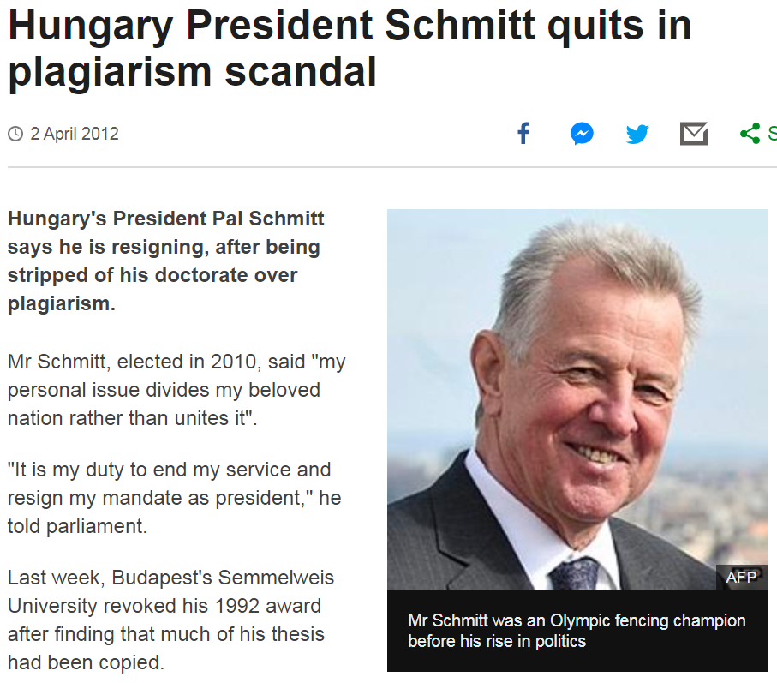
https://www.bbc.co.uk/news/world-europe-17586128

Slide 4
Plagiarism
“Using or copying the work of others (whether written, printed or in any other form) without proper acknowledgement in any assignment, examination or other assessed work”
https://moodle.essex.ac.uk/course/view.php?id=5844

Slide 5
How to avoid plagiarism
“If you use the work of others, you must either quote it or paraphrase it, but whichever method you choose, you must include a citation and reference”
https://moodle.essex.ac.uk/course/view.php?id=5844
Note that I included this link on my slide – this is because I took the quoted text from this page.
But if you write an essay, such link (URL) is not enough!

Slide 6
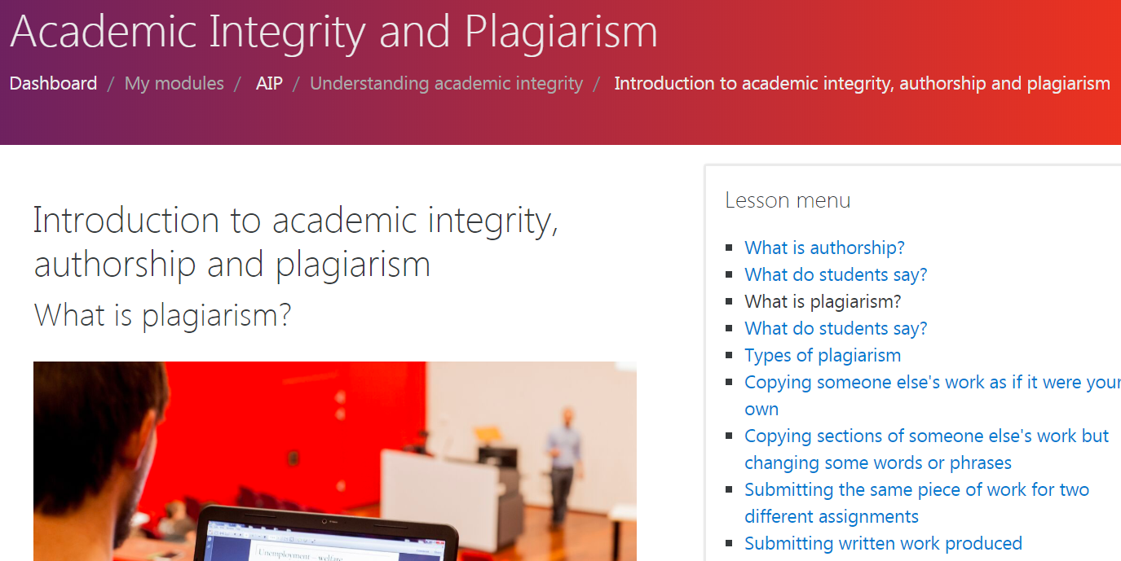
Take this course online: https://moodle.essex.ac.uk/course/view.php?id=5844

Slide 7
Forms of plagiarism https://www.ox.ac.uk/students/academic/guidance/skills/plagiarism
Verbatim (word for word) quotation without clear acknowledgement
Pasting from the Internet without acknowledgement
Paraphrasing without acknowledgement
Collusion (unauthorised collaboration between students)
Inaccurate citation (usually “unintended plagiarism”)
Failure to acknowledge assistance
Use of material written by professional agencies or other persons (or by another student)
Auto-plagiarism (self-plagiarism)

Slide 8
Today you can’t get away with plagiarism
Every text can be easily checked against billions of electronic documents, web sites, etc. Just for fun, try to check your text at duplichecker.com
We have a much more powerful system that we use in the university to check for plagiarism.
Any image can be also checked against billions of images on Google. Try it yourself: https://www.google.com/imghp

Slide 9
Even if your plagiarism is not detected immediately, it can be still detected several years later and lead to serious problems. (You don’t need to be a minister for this). If you plagiarised, it is not good for your “karma” – you will be living in a constant fear of being exposed.
Don’t plagiarise

Slide 10
1) Text 2) Images 3) Audio, video, etc. 3) Ideas 4) Scientific results
What can be plagiarised
We usually deal with these,
at least for 1st year students
Will be important in your
3rd year research projects

Slide 11
Don’t forget quotation marks
If you copy text verbatim (word for word), you have to use quotation marks and refer to the source.
You can put in quotation marks a single word (if it’s used in a non-trivial meaning) or 1-2 sentences.
But if you quote large chunks of text, or use quotes too frequently, it rises questions about your ability to write in your own words and may decrease your mark.

Slide 12
Don’t overuse quotation
We usually don’t need and rarely use word-for-word copying in biology (unlike social sciences)
In fact, when an author uses quotation marks in a biological article, it may mean:
a) The author wants to distance from the quote (does not agree or not sure whether this statement is correct);
b) The word is used in a non-standard meaning.
For example, I once wrote in an article that a molecule is “hiding” – obviously, molecules can’t consciously hide, and quotation marks show that I am aware of this.

Slide 13
Figures and drawings
If you use figures or drawings from textbooks, papers or the Internet, say where they came from
If you draw your own version (or add additional details) you still need to state that the figure is based on, or adapted from, and the source of the figure
By the way, this note at the bottom of my slide means that in preparation of my slide presentation I used slides from Prof Ian Colbeck (which he agreed to share), and this slide is adopted from his slide.
Adopted from Ian Colbeck

Slide 14
Slide by Ian Colbeck

Slide 15
Literature references
All scientific papers or patents include references.
You must fully reference the sources of all ideas and results that you are quoting or using.
References show the reader that you have read and can integrate information from different sources.
No need for references for information which is common knowledge e.g. The River Colne flows through Colchester. Sometimes hard to judge which information is common knowledge. If you are unsure, it’s better to provide a reference.
Adopted from Ian Colbeck

Slide 16
How to make a reference
A literature reference (aka citation) contains two parts
1) In-text citation in the body of your essay:
Example A: Smith (2001) showed that aminobenzamide inhibits PARP-1 activity in lymphocytes.
Example B: Aminobenzamide has been shown to inhibit PARP-1 activity in lymphocytes (Smith, 2001).
2) Full reference at the end of your essay:
Smith, J.C. (2001) Effect of inhibition of PARP-1. J. Cell Science, 47, 123-132.

Slide 17
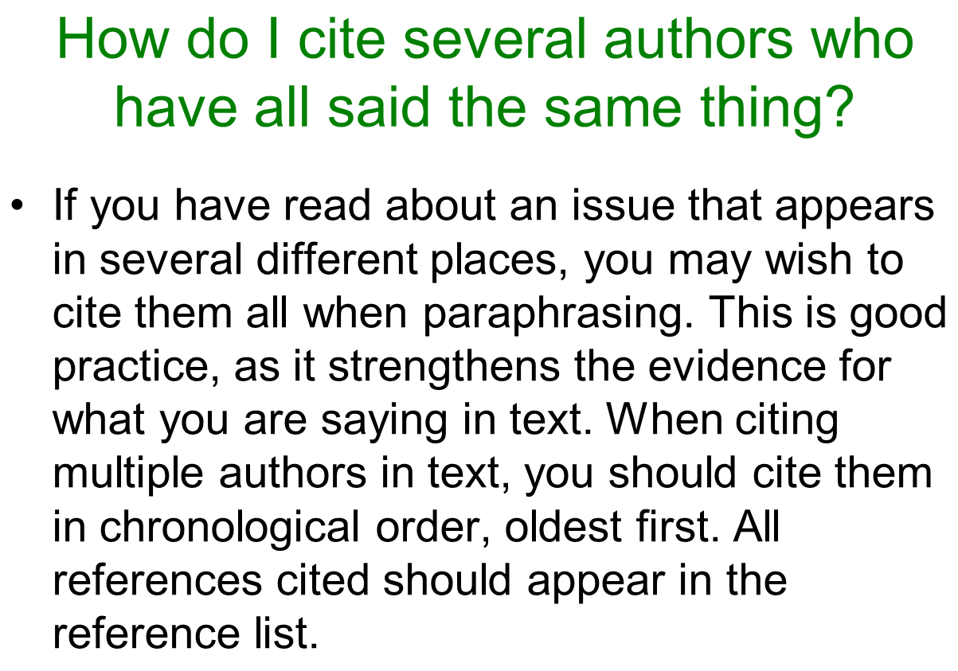
Slide by Ian Colbeck

Slide 18
Slide by Ian Colbeck

Slide 19
Slide by Ian Colbeck

Slide 20
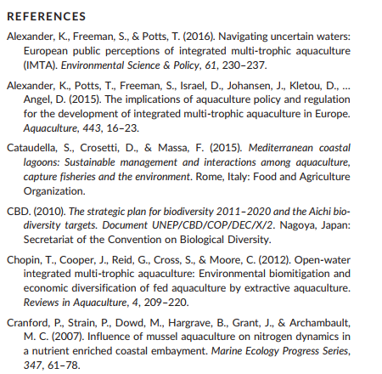
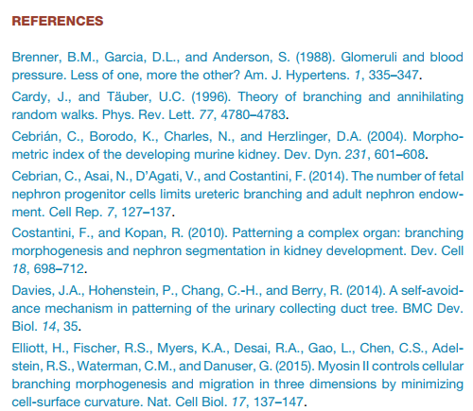
Hannezo, E., Scheele, C.L., Moad, M., Drogo, N., Heer, R., Sampogna, R.V., van Rheenen, J. and Simons, B.D. (2017) A Unifying Theory of Branching Morphogenesis. Cell, 171, 242-255.
Le Gouvello, R., Hochart, L.E., Laffoley, D., Simard, F., Andrade, C., Angel, D., Callier, M., De Monbrison, D., Fezzardi, D., Haroun, R. and Harris, A. (2017) Aquaculture and marine protected areas: Potential opportunities and synergies. Aquatic Conservation: Marine and Freshwater Ecosystems, 27, 138-150.
Slide by Ian Colbeck

Slide 21
Harvard reference format
Author’s last name
Author’s initials
Article title
Year
Smith, J.C. (2001) Effect of inhibition of PARP-1.
J. Cell Science, 47, 123-132.
Article pages (sometimes the journal is electronic only, and then instead of pages there is an article number)
Journal volume
Journal name (official shortened name, from the full name “Journal of Cell Science”)

Slide 22
Harvard format, two authors
In-text citation:
Just 5 minutes of 'green exercise' is optimal for good mental health (Barton and Pretty, 2010).
Reference at the end of the essay:
Barton, J. and Pretty, J. (2010) What is the best dose of nature and green exercise for improving mental health? A multi-study analysis. Environmental Science & Technology, 44, 3947-3955.

Slide 23
Harvard format, >2 authors
In-text citation:
Godfray et al. (2010) discussed the enormous challenges of making food production sustainable
Reference at the end of the essay:
Godfray, H.C.J., Beddington, J.R., Crute, I.R., Haddad, L., Lawrence, D., Muir, J.F., Pretty, J., Robinson, S., Thomas, S.M. and Toulmin, C. (2010) Food security: the challenge of feeding 9 billion people. Science, 327, 812-818.

Slide 24
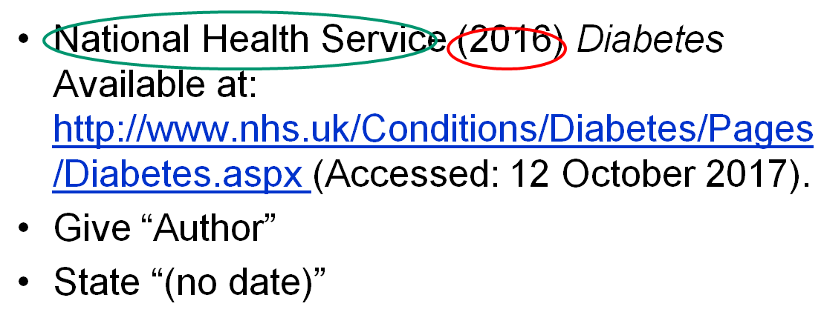
Harvard format, referencing web pages
Example by Ian Colbeck
Hint: Avoid citing web pages. Aim to cite only peer-reviewed academic journals or books

Slide 25
Referencing mistakes
Wrong: Jones T, Murray R. (2011). Current research in and development of treatments for Parkinson's disease. Available: https://www.pharmaceutical-journal.com/news-and-analysis/news/current-research-in-and-development-of-treatments-for-parkinsons-disease/11083642.article?firstPass=false. Last accessed 7/2/19.
Correct: Jones ,T., Murray, R. (2011). Current research in and development of treatments for Parkinson's disease. The Pharmaceutical Journal, 287, 293
Explanation: This is a journal article, not a web page; therefore, it needs the journal name, volume number and pages (in this case just the first page is known). URL is not needed in this case.

Slide 26
Referencing mistakes
Wrong: Oakley, J., 2002. Democracy, embryonic stem cell research, and the Roman Catholic church. Journal of Medical Ethics, 28(4), pp.228–228. Available at: http://jme.bmj.com/content/28/4/228.abstract.
Correct: Oakley, J., 2002. Democracy, embryonic stem cell research, and the Roman Catholic church. Journal of Medical Ethics, 28(4), 228–228.
Explanation: This is a journal article, not a web page; therefore, URL is not needed.
In-text citation: "It was shown that ... (Oakley, 2002)" or "Oakley (2002) argues that ..."

Slide 27
Referencing mistakes
Wrong: Holland, S., Lebacqz, K. and Zoloth, L. (2001) The human embryonic stem cell debate: Science, ethics, and public policy. Available at: https://books.google.co.uk/books?hl=en&lr=&id=R1wV2pNTRfwC&oi=fnd&pg=PR11&dq=embryonic+stem+cells+government+ethics&ots=7Hj8s_PbIH&sig=xa2UM3Y4j7mOOUOROu3TArR5XTA#v=onepage&q=embryonic%20stem%20cells%20government%20ethics&f=false (Accessed: 2 February 2017).
Correct: Holland, S., Lebacqz, K. & Zoloth, L. (eds) (2001) The human embryonic stem cell debate: Science, ethics, and public policy. Cambridge, Massachusetts, MIT Press.
Explanation: This is a book, not just a web page; therefore, it requires all proper book credentials and does not require URL

Slide 28
Referencing mistakes
Wrong: Coghlan, A., New Scientist, 2014. Stem cell timeline: The history of a medical sensation. https://www.newscientist.com/article/dn24970-stem-cell-timeline-the-history-of-a-medical-sensation/. Last accessed 09 December 2016.
Correct: Coghlan, A., 2014. Stem cell timeline: The history of a medical sensation. New Scientist. [online] Available at: https://www.newscientist.com/article/dn24970-stem-cell-timeline-the-history-of-a-medical-sensation/. Last accessed 09 December 2016.
Explanation: This is a magazine article, not just a web page; therefore, the name of the magazine is an essential part of the reference.

Slide 29
Referencing mistakes
Wrong: Explorestemcells.co.uk. (2017). Stem Cell Research Around the World. [online] Available at: http://www.explorestemcells.co.uk/stemcellresearcharoundworld.html [Accessed 3 Feb. 2017].
Correct: Murnaghan, I., 2017. Stem Cell Research Around the World [online] Available at: http://www.explorestemcells.co.uk/stemcellresearcharoundworld.html [Accessed 3 February 2017].
Explanation: Every text, even a text on a web page, has an author (it can be a collective author such as an organization, a web pseudonym, or "anonymous", but there is always some author). This is an essential part of the reference.

Slide 30
Referencing mistakes
Wrong: Council, M.R. (2014) Regenerative medicine & stem cells - our research - medical research council. Available at: http://www.mrc.ac.uk/research/initiatives/regenerative-medicine-stem-cells/ (Accessed: 10 January 2017)
Correct: Medical Research Council, 2017. Regenerative medicine & stem cells [online]. Available at: http://www.mrc.ac.uk/research/initiatives/regenerative-medicine-stem-cells/ [Accessed: 10 January 2017]
Explanation: The name of organization (Medical Research Council) is misinterpreted as a person whose last name is Council. This funny situation is actually quite frequent in essays that I am marking. To avoid it, make sure you specified the proper type of reference in your referencing software, and also check it manually.

Slide 31
Referencing mistakes
Wrong: Human Fertilisation and Embryology Authority. http://www.hfea.gov.uk/134.html. Last accessed: 01/01/17
Wrong: The National Archives: Department of Health (2012): http://webarchive.nationalarchives.gov.uk/+/www.dh.gov.uk/ab/UKSCI/index.htm Last accessed 29th January 2017
Correct: Human Fertilisation and Embryology Act 2008. [online] Available at: http://www.legislation.gov.uk/ukpga/2008/22/contents. Last accessed: 01/01/17
Explanation: In this case the web page cited by the student contained a link to the legislative act which should have been followed. The original legislative act has to be cited, not one of the myriads of web pages describing it.

Slide 32
Hints to avoid referencing mistakes
Avoid citing “grey” literature (anything except books, journals, preprints, theses).
Pay attention to special styles when citing patents and legislation documents.
Use Word + EndNote (essex.ac.uk/staff/it-services/endnote
Or “Cite them right online”, see https://library.essex.ac.uk/referencing
Always manually check citations
(every software can make mistakes)
https://www.authorea.com/users/113502/articles/157923-a-student-guide-to-citations

Slide 33
Finding peer-reviewed articles
PubMed (ncbi.nlm.nih.gov/pubmed)
Google Scholar (https://scholar.google.com)
Our library (https://library.essex.ac.uk)

Slide 34
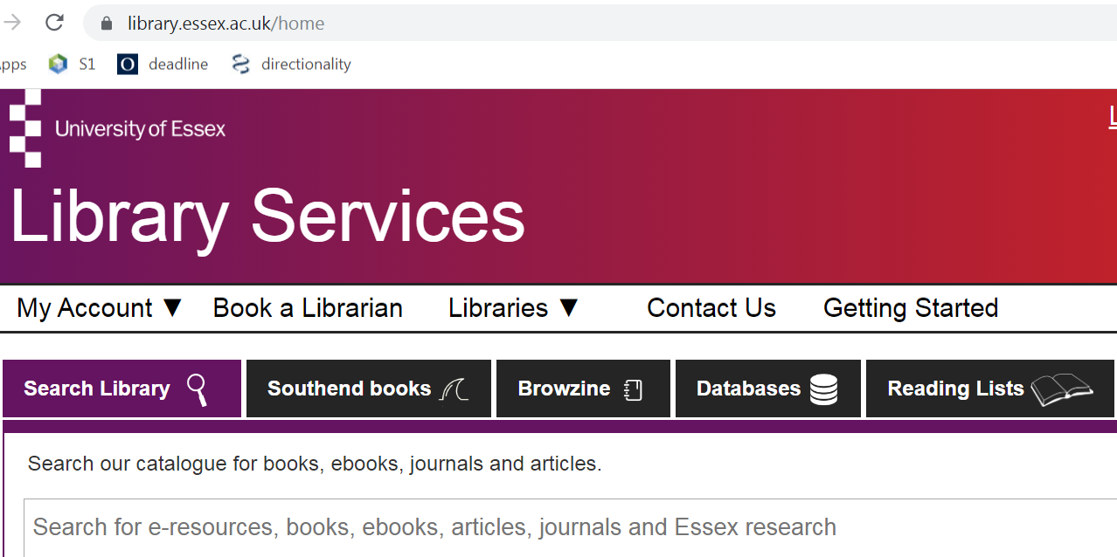
Literature search in our library

Slide 35
Biomedical literature in PubMed
Includes only peer-reviewed journals
Advanced search (author, year, journal, etc)
Not possible to track citations

Slide 36
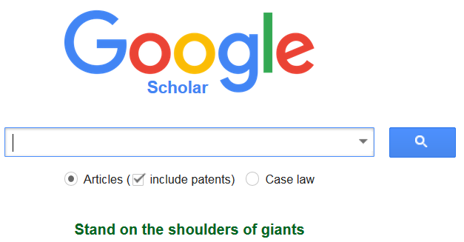
Literature in Google Scholar
Includes PDFs from all respectful sources
(such as e.g. your personal web site ☺)
Allows to sign up for search alerts
It is possible to track citations
Allows to create your own profile

Slide 37
Citing literature references
EndNote (for Windows and Mac)
essex.ac.uk/staff/it-services/endnote
Papers (for Mac, expensive license)
Mendeley (online, needs registration)
Other solutions:
https://en.wikipedia.org/wiki/Comparison_of_reference_management_software

Slide 38
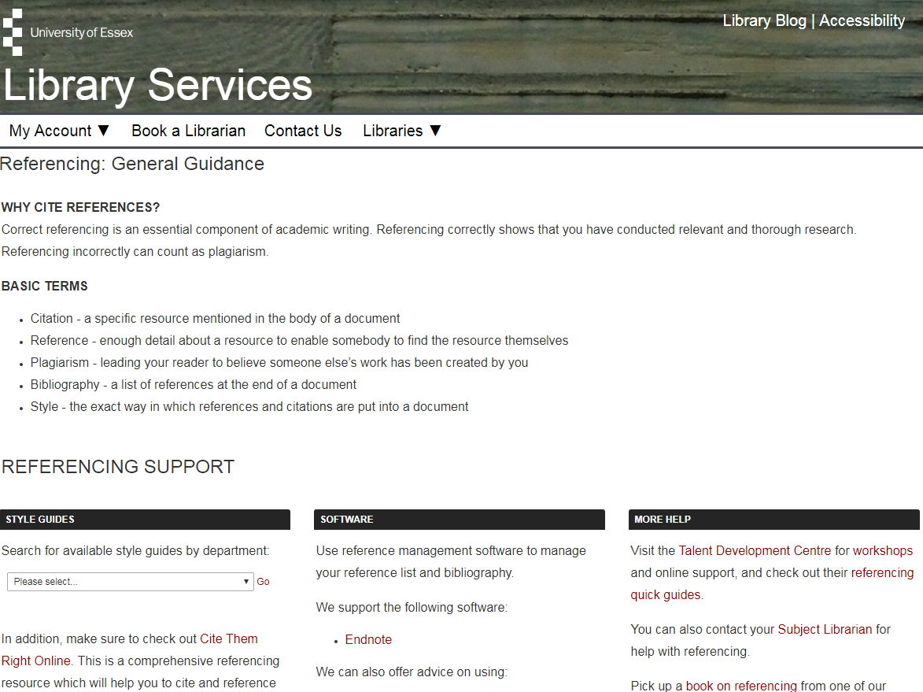
https://library.essex.ac.uk/referencing
Adopted from Ian Colbeck

Slide 39
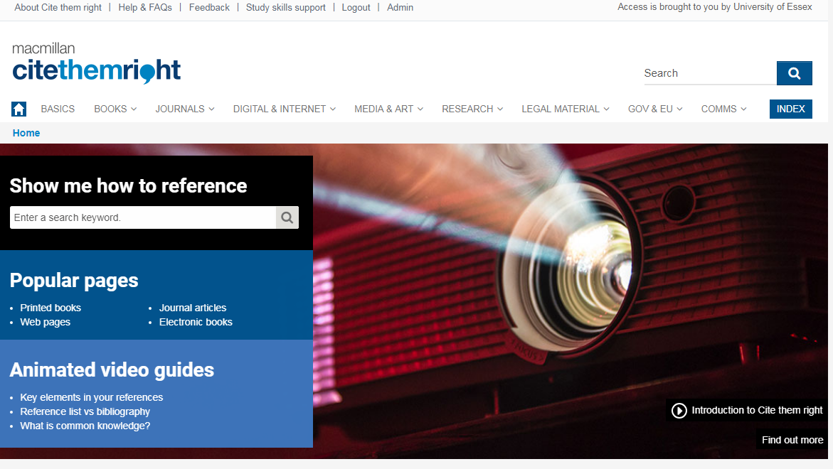
https://www.citethemrightonline.com/
(need to log in from a university computer or through our university’s library website)
Adopted from Ian Colbeck

Slide 40
Questions?
vteif@essex.ac.uk

